Slide 1
Direct Measurement of the Soft Mode Driving a Quantum Phase Transition
Daniel Silevitch

Slide 2
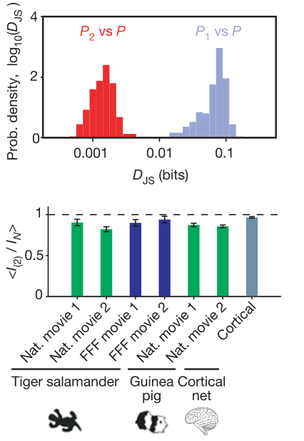
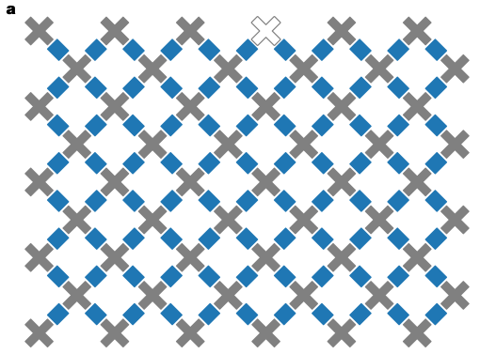
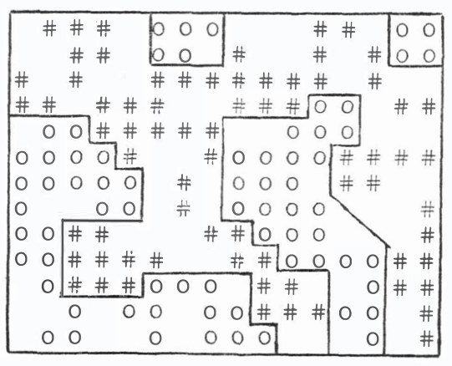
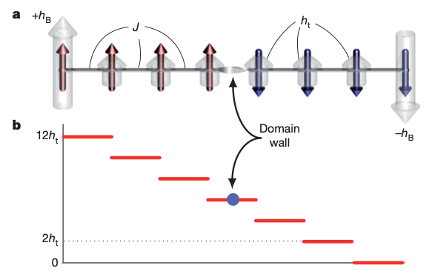
Introduction: The Quantum Ising model
$$\overset{̂}{H}=−\underset{i,j}{∑}J_{ij}S_{i}^{z}⋅S_{j}^{z}$$
J
S=1/2 Ising model
Used to model wide variety of systems across physics and beyond
Magnetism
Lattice Gas models
Trapped Ions
Quantum annealing
Quantum programmable gates
Neurobiology
Sociology
$$=−J\underset{<n.n.>}{∑}S_{i}^{z}⋅S_{j}^{z}$$
T.D. Lee and C.N. Yang, Phys. Rev. 87, 410 (1952)
R. Islam et al., Science 340 587 (2013)
M.W. Johnson et al., Nature 473, 194 (2011).
F. Arute et al, Nature 574, 505 (2019)
E. Schneidman et al., Nature 440, 1007–1012 (2006)
T.C. Schelling, J. of Math. Soc. 1, 143 (1971)

Slide 3
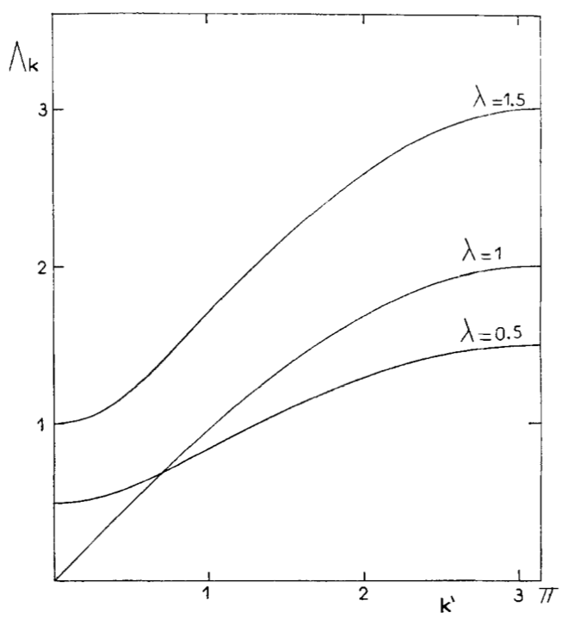
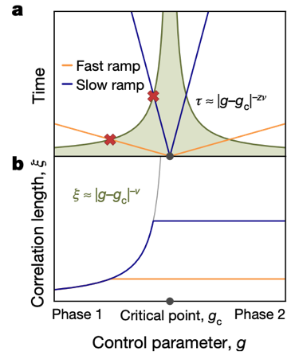
Transverse-Field Ising Model
Add in transverse field: $\overset{̂}{H}=−\underset{i,j}{∑}J_{ij}S_{i}^{z}⋅S_{j}^{z}−Γ\underset{i}{∑}S_{i}^{x}$
Tunable quantum tunneling and fluctuations; eventual destruction of ordered state
2nd-order quantum phase transition
Quantum critical behavior
Model system for understanding dynamics of QPT
Excitation modes near phase transition; mode softening to zero at critical field
Defect formation on quenching through transition
Γ
Paramagnet
F
Ferromagnet
T
P. Pfeuty, Annals of Physics. 57, 79 (1970).
A. Keesling et al., Nature. 568, 207 (2019).

Slide 4
The Real World: Dissipation and spin baths
Fluctuation-dominated regime highly sensitive to environmental effects
Complete mode softening nominally requires isolated system
Soft mode predicted in theory; does it persist in non-ideal systems?
Model non-ideal behavior by placing spins in contact with incoherent “bath”
Nuclear spins, paramagnetic impurities, other 2-level systems
Framework to understand decoherence, dissipation, etc.
N. V. Prokof’ev, P. C. E. Stamp, Reports on progress in physics. 63, 669–726 (2000).

Slide 5
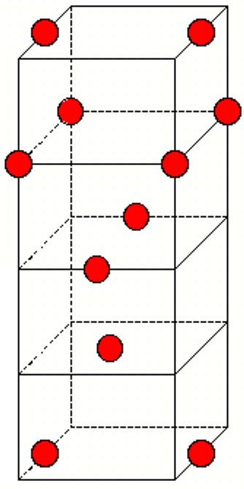
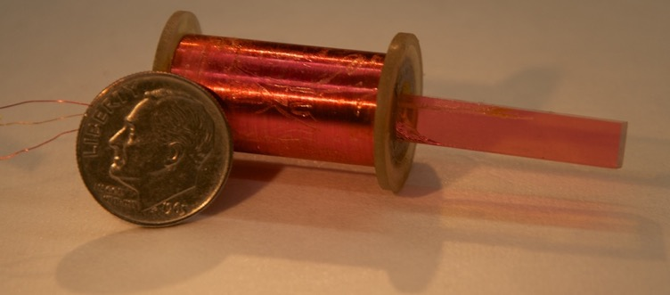
LiHoF4: A model Ising ferromagnet
Magnetic species: Ho³⁺ ions
Crystal fields yield doubly-degenerate ground state; first excited state at 9.4 K
Dipole-coupled Ising Ferromagnet, TC=1.53 K
Transverse field mixes ground state with first excited state, splits degeneracy with $Γ∝H_{t}^{2}$ at low fields
Large (cm-scale) single crystals commercially available (YLF:Ho laser rods)
Ising Axis
10.75 Å
5.175 Å

Slide 6
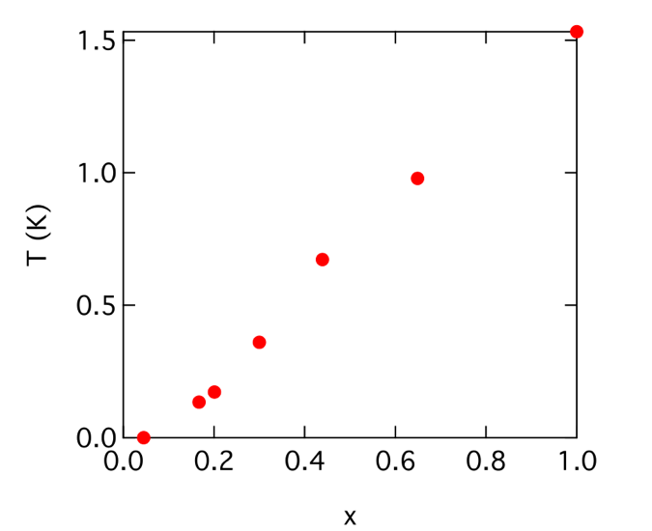
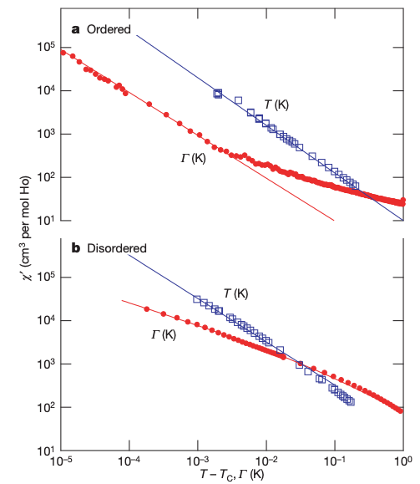
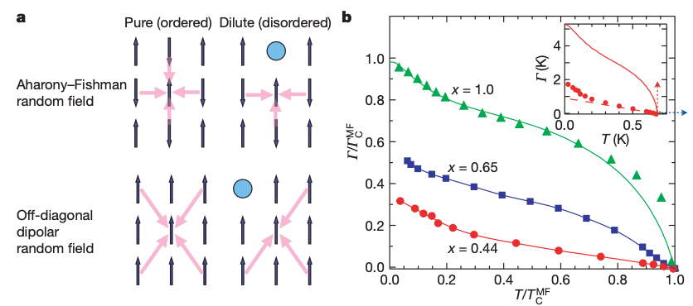
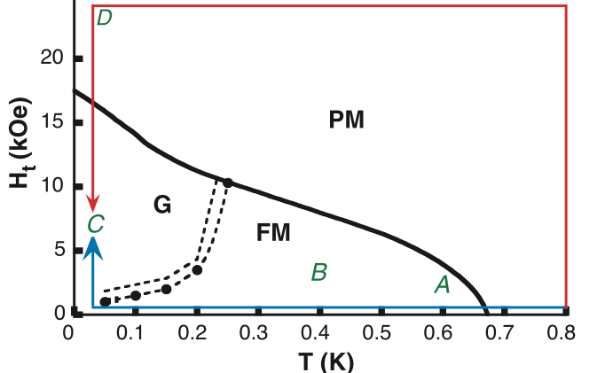
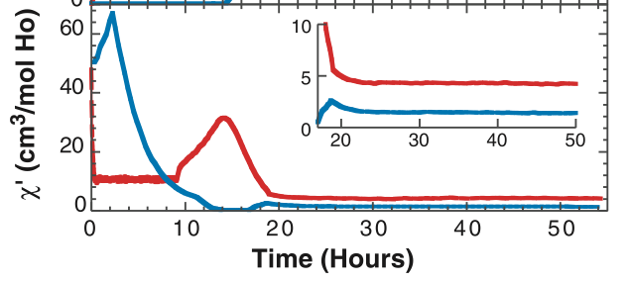
Tuning the Ising Magnet: LiHoxY1-xF4
Replace magnetic holmium with non-magnetic yttrium
$0.3<x<1$ : ”Random Field” Ferromagnet with lowered TC
Transverse field enables quantum annealing
$x=0.1−0.2$ : Spin Glass
$x=0.045$ : Spin Liquid
$x≪0.01$: Decoupled Spins
LiHoxY1-xF4
PM
FM
SG
D.H. Reich et al., Phys. Rev. B 42 4631 (1990)
D.M. Silevitch et al., Nature 448 467 (2007)
J. Brooke et al., Science 284 779 (1999)

Slide 7
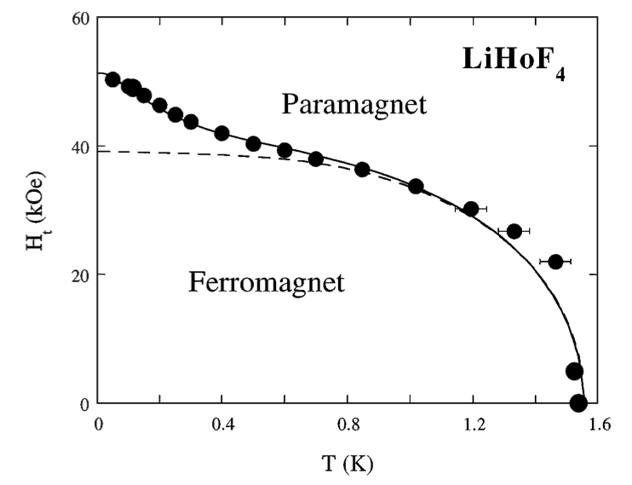
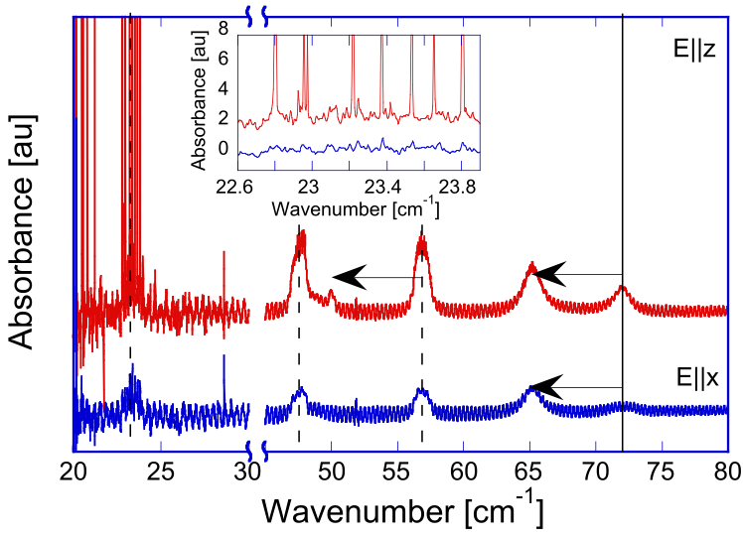
LiHoF4: Adding the nuclear spins
Hyperfine interactions shift ground state behavior
$I=7/2$ holmium nuclear spins
Effective Hamiltonian: $ℋ=V_{c}−g_{⊥}μ_{B}H_{t}J_{x}+A(\overset{̂}{I}⋅\overset{̂}{J})−2J_{0}⟨\overset{̂}{J_{z}}⟩\overset{̂}{J_{z}}$
Effective rescaling of electronic spin moment
Low-temperature upturn in phase diagram
Hybridization into “electronuclear” spins
m = +7/2
S=+1/2
~3 GHz
m = -7/2
~200 GHz
m = -7/2
S=-1/2
m = +7/2
D. Bitko et al., Phys. Rev. Lett. 77, 940 (1996)
G. Matmon et al., PRB 94, 205132 (2016).

Slide 8
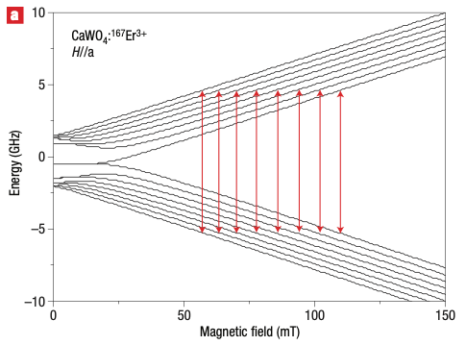
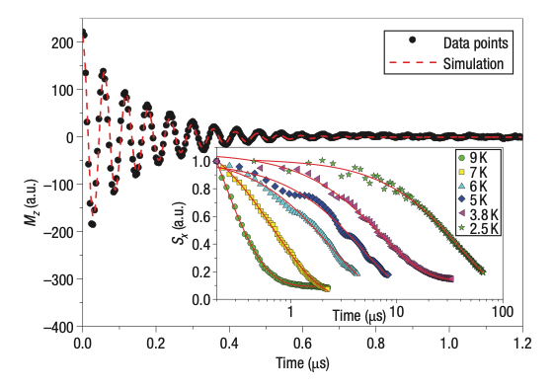
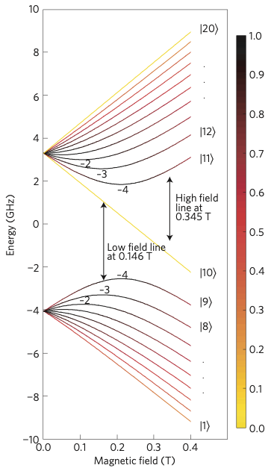
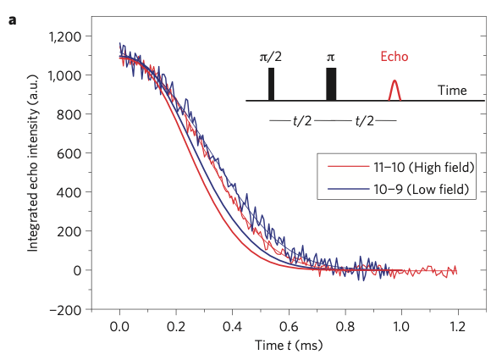
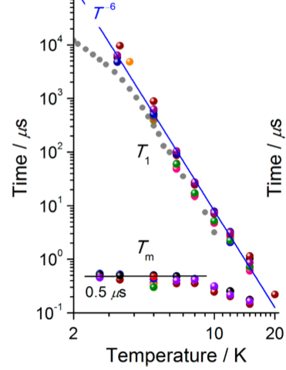
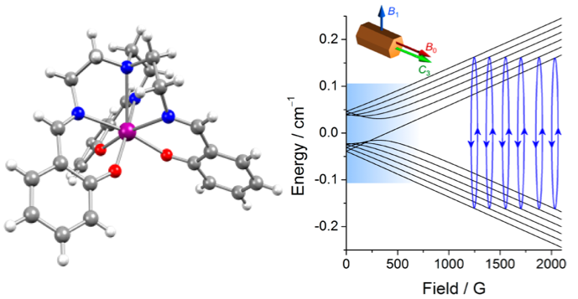
Electronuclear spin systems as qubit candidates
Hyperfine interactions create several discrete transitions
Enable multiple individually-addressable qubits per site
Ions with strong nuclear moments embedded in matrix of electronic spins
Many potential physical realizations
CaWO4:Er
Silicon:Bismuth
Single-ion magnet: Yb(trensal)
S. Bertaina et al., Nature Nanotech. 2, 39–42 (2007)
G. W. Morley et al., Nature Materials. 12, 103–107 (2013)
K. S. Pedersen et al., J. Am. Chem. Soc. 138, 5801–5804 (2016)

Slide 9
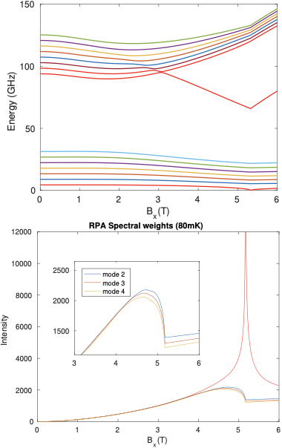
Probing the electronic excitations
Effective Hamiltonian:
$H_{eff}= H_{e}+ H_{NS}$
$H_{e} = −\sum_{i<j}{V_{ij}\left(B_{x}\right) σ_{i}^{z}σ_{j}^{z}}−Δ\left(B_{x}\right)\sum_{i}{σ_{i}^{x}}$
$H_{NS}=\sum_{i}{Δ_{n}⋅I_{i}+A_{z}\sum_{i}{σ_{i}^{z}I_{i}^{z}+(A_{⊥}\sum_{i}{σ_{i}^{+}I_{i}^{−}+A_{++}\sum_{i}{σ_{i}^{+}I_{i}^{+}}+h.c)}}}$
Solve using finite-temperature Random-Phase Approximation approach
Two bands of excitations. Lowest mode softens completely at phase transition
Spectral weight of soft mode dominates near transition
Prediction: True QPT should exist even with spin bath

Slide 10
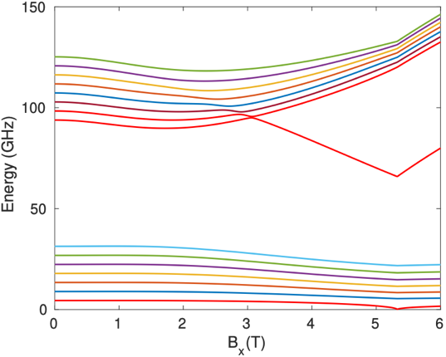
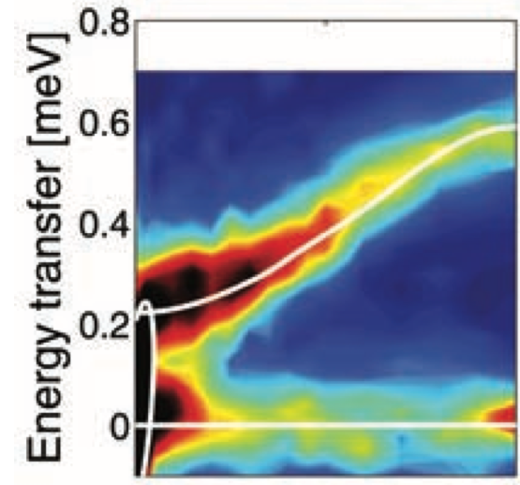
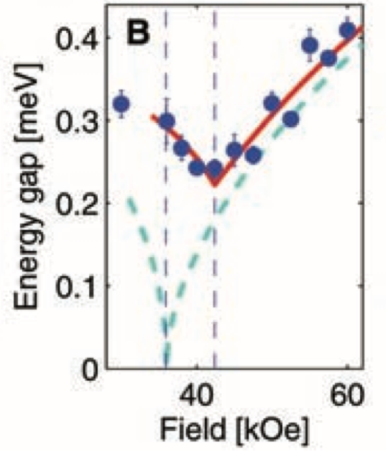
Probing the electronic excitations
Inelastic neutron scattering measurements near quantum phase transition
Energy scale of interband transition
Pure soft mode in absence of electronuclear coupling
To resolve electronuclear excitation structure, need energies 1-2 orders of magnitude lower
Track excitation modes to below kBT (3-4 μeV, <1 GHz)
H. Rønnow et al., Science 308, 389–392 (2005)

Slide 11
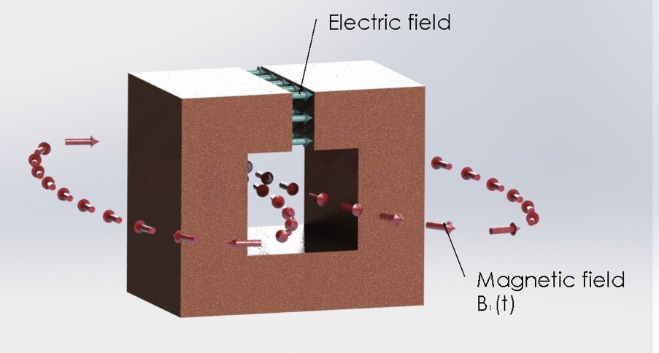
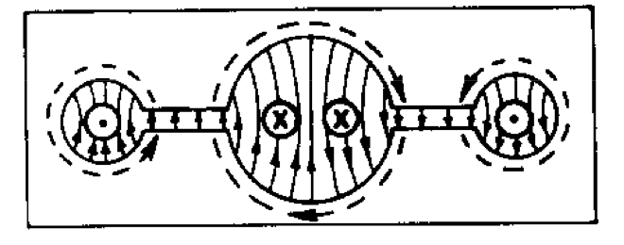
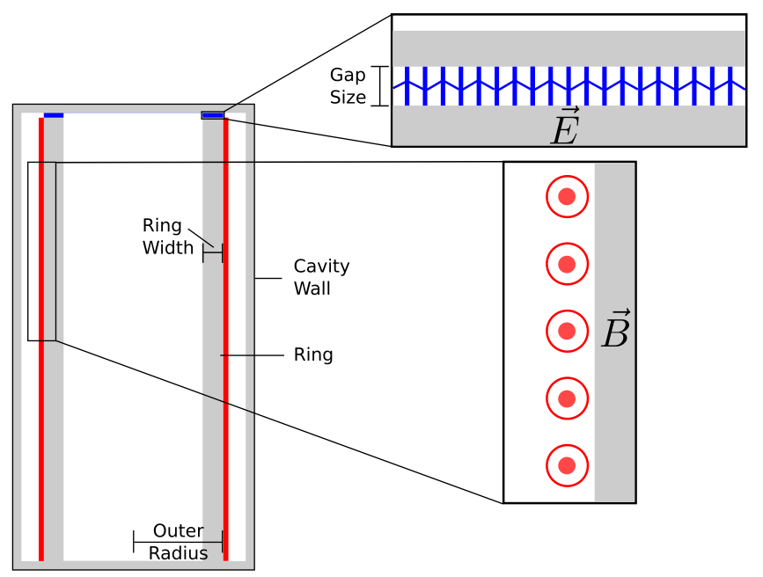
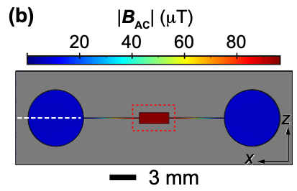
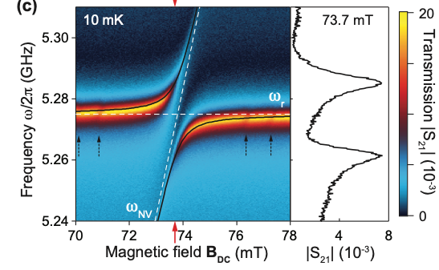
Loop-Gap Resonators for probing low energies
At low frequencies, cavities can be too large for apparatus constraints
2-d resonators (stripline, etc.) have poor uniformity/filling factor for bulk materials
Loop-gap resonator design: effective capacitor-inductor resonant circuit with wide frequency range
ESR: R. L. Wood et al., J. Magn. Res. 58, 243–253 (1984)
Diamond NV centers: J. Ball et al, Appl. Phys. Lett. 112, 204102 (2018)
Axion Dark Matter: B. T. McAllister et al., Phys. Rev. D 94, 042001 (2016).

Slide 12
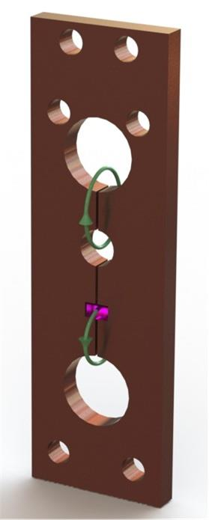
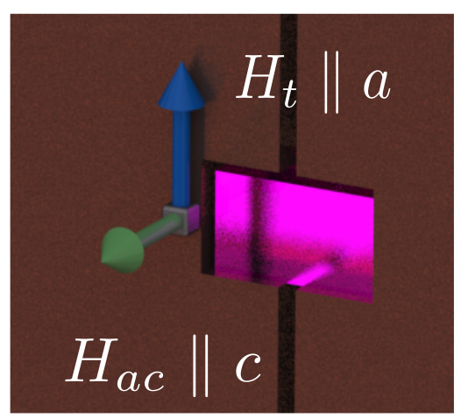
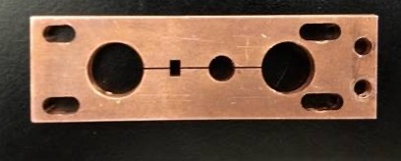
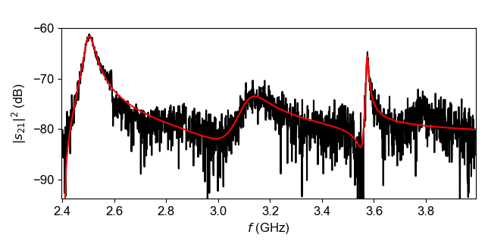
Microwave Measurements of LiHoF4
4-loop 3-gap resonator to probe two frequencies simultaneously
Tune frequencies with sapphire shims in gaps
Microwave magnetic field along Ising axis
OFHC copper for magnetic-field compatibility
0.9-5 GHz frequency range
Static magnetic field in transverse plane
All data taken at 80 mK
Ht = 5 T
1 cm

Slide 13
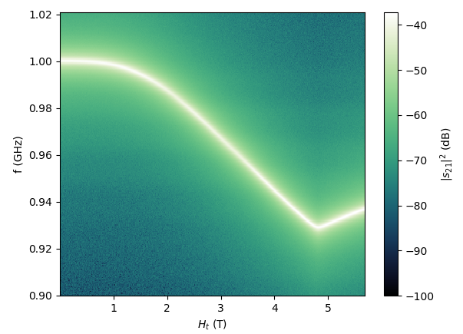
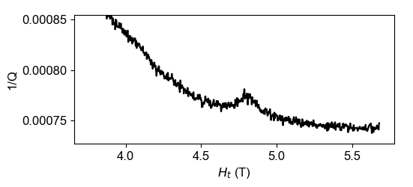
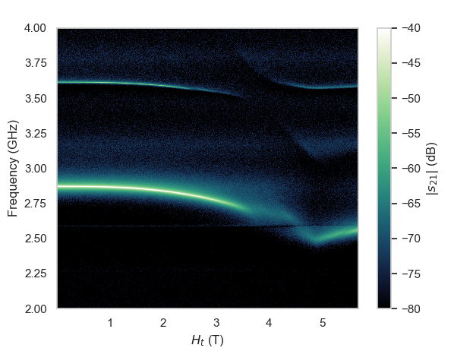
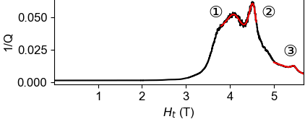
Tracking the soft mode in LiHoF4
Measure spectra; scan magnetic field
Resonator f0 and Q give inductive and dispersive components of LiHoF4.
Enhanced dissipation (peak in 1/Q) gives (Ht,f) position of mode
Near 4.9 T QPT: Dispersive mode seen down to 930 MHz (3 μeV)
Lower energies difficult to scan due to thermal occupation of states (T=80 mK = 1.7 GHz)
0.5 T below QPT: Mode at ~2.6 GHz, avoided level crossings due to hybridization with resonator photons
Mode softens to below kBT at cusp of phase transition

Slide 14
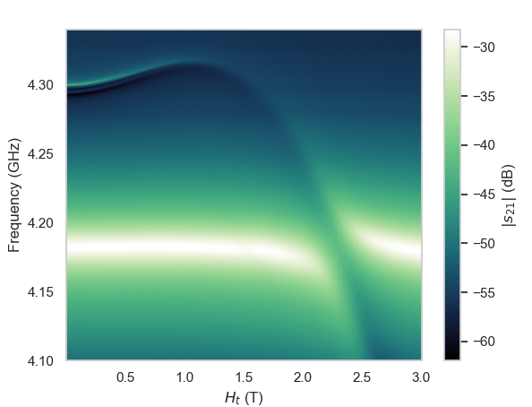
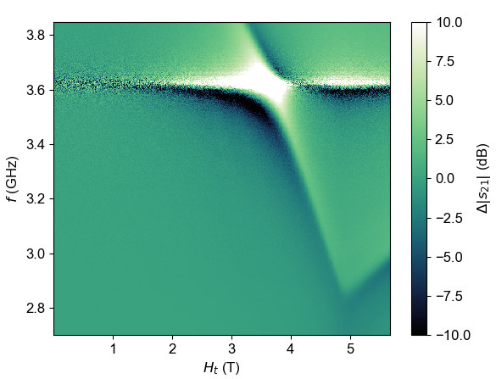
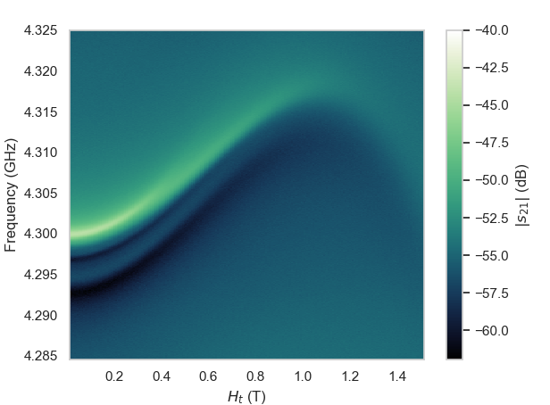
Higher excitation modes
Away from QPT, E23 and E43 mode predicted to have larger spectral weight
Can do continuous tracking off-resonance from LGR mode
Two nearly-degenerate modes; non-monotonic field dependence
Avoided level crossing with resonator mode: model; enhanced magnon-photon coupling over limited frequency range
Higher modes do not soften to zero at QPT; minimum frequency 2.9 GHz
Near QPT, difficult to disentangle E23 and E43 mode

Slide 15
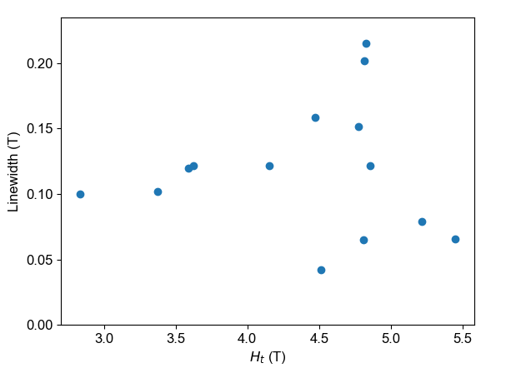
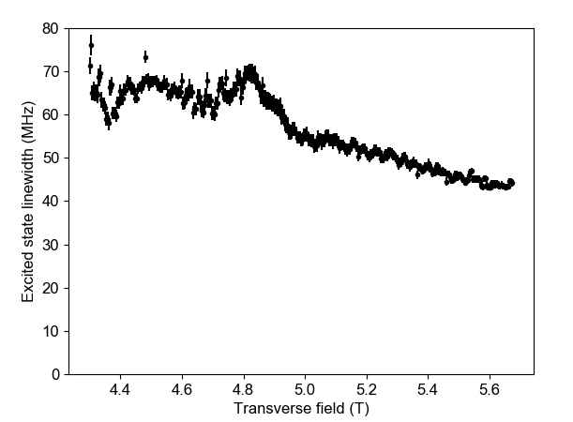
Fluctuations near the critical point
Compare effects of fluctuations on first mode (E21) vs. higher modes (E32, E43)
Look at evolution of linewidth in vicinity of critical point
Soft mode: Linewidth approximately doubles: strongly fluctuation-dominated
Higher excitation modes: Slight increase of linewidth (~15%): true critical behavior is cut off by gap even right at Hc.
Soft Mode
(E21)
Higher modes
(E32, E43)

Slide 16
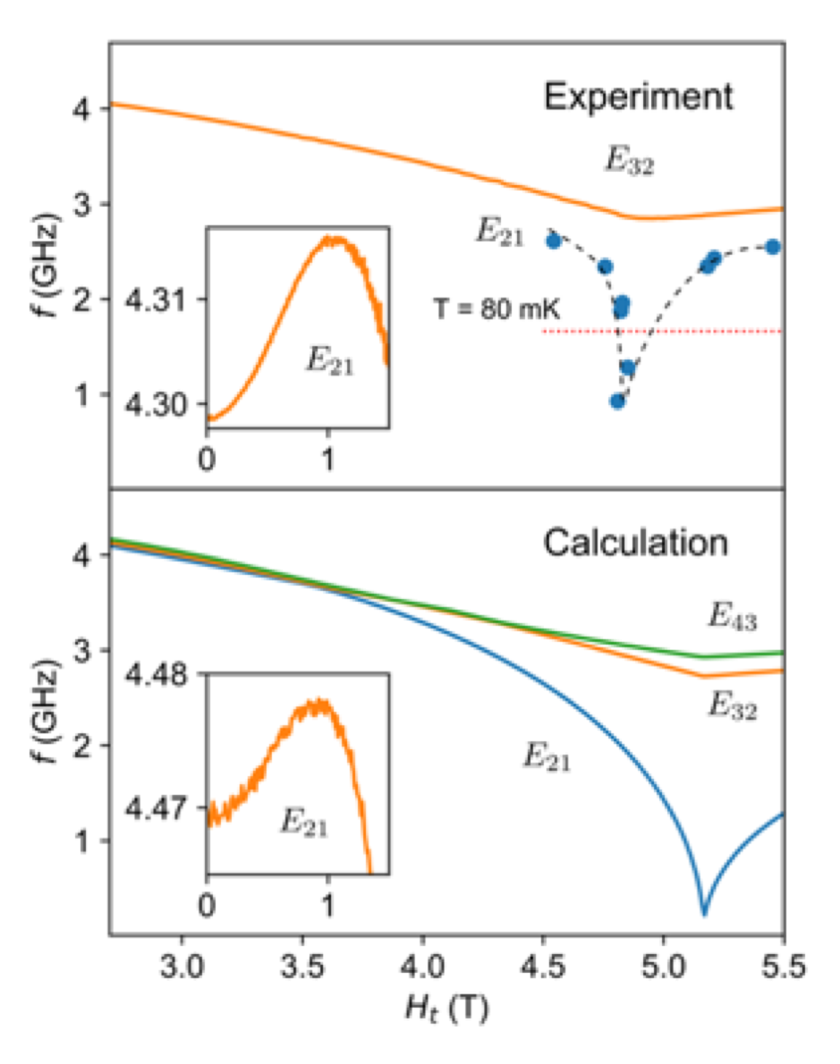
Comparison of measurements and model
Low energy excitation persists to below 1 GHz (below kBT)
Excited-state transitions continuously trackable over entire magnetic field range
Some indications in data of E43, working on unambiguous fits to separate modes
RPA model accurately describes observed data, including low-field non-monotonic feature
Model omits mode-mode coupling: drives 7% mismatch in critical field

Slide 17
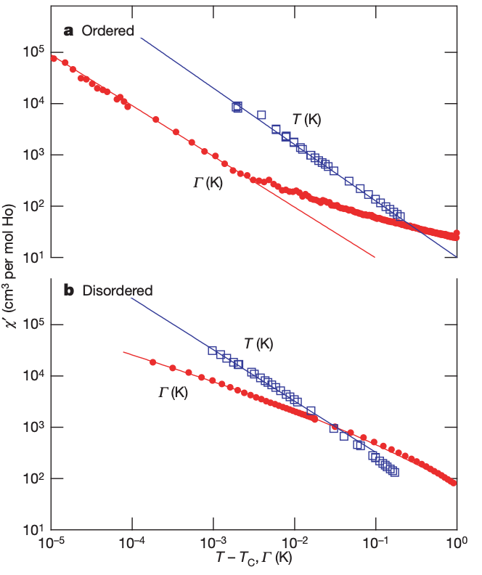
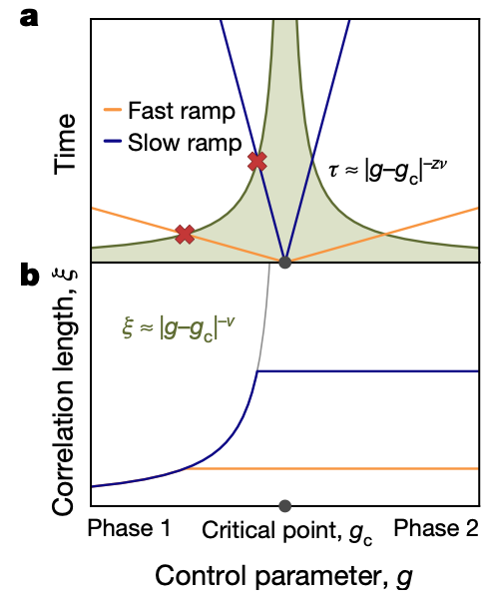
Next steps and open questions
Is the soft mode robust under change of universality class?
Introduce disorder via Y doping
New critical exponents at QPT
Does disorder cut off mode softening?
Related AF compound LiErF4
Nonlinear response: What happens if we drive the mode population out of equilibrium?
Allow rapid transition between ferromagnet and paramagnet states
Quench dynamics
LiHoF4
Classical
Quantum
LiHo0.44Y0.56F4
Quantum
D.M. Silevitch et al., Nature 448 467 (2007)
D. Bitko et al., Phys. Rev. Lett. 77, 940 (1996)
A. Keesling et al., Nature. 568, 207 (2019).

Slide 18
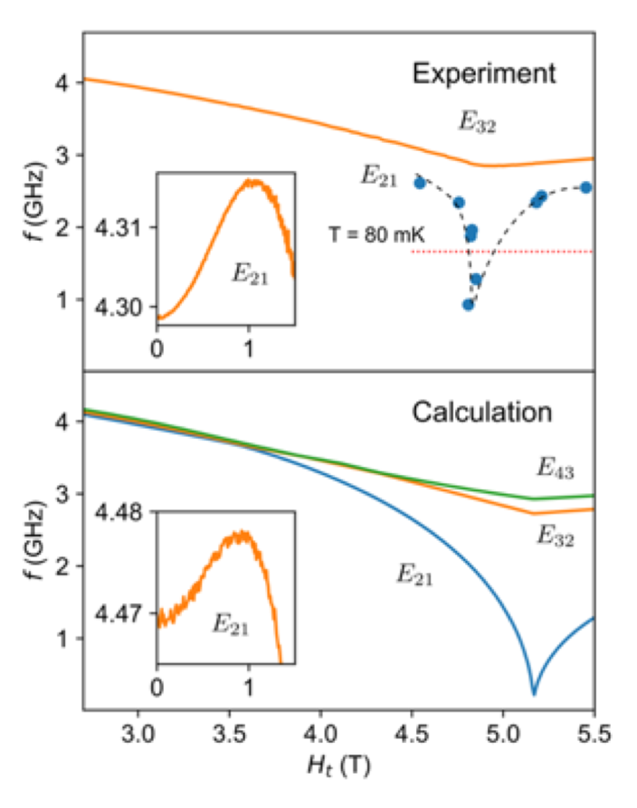
Summary and Outlook
RF spectroscopy to probe low-energy modes in vicinity of quantum phase transition
Finite-temperature RPA calculations to connect with underlying Hamiltonian
Quantum criticality persists in presence of incoherent nuclear spin bath
Importance of understanding hybridized collective modes
Beyond quantum criticality, understanding hybridized collective modes applies to quantum annealing and similar problems

Slide 19
Acknowledgements
Caltech
Thomas Rosenbaum
Matthew Libersky
Hayward Melton
UBC
Philip Stamp
Ryan McKenzie

