Slide 1
Origins of Higgs Physics
It’s good to talk to each other

Slide 2
Symmetry and quantum mechanics
Schrodinger and Weyl
QM=“Applied Group Theory”—operators are generators of symmetries: p=ħ/i d/dx ; H=iħd/dt, etc. (continuous symmetries –not discrete)
Weyl: gauge principle: gauge field=phase of Ψ. Interactions from symmetry! (making local from global, in spirit of GR)
Symmetry=conservation=interaction

Slide 3
Broken Symmetry in Condensed Matter
Thermal Phase Transitions: Landau-Tisza Formalism. Quantum theory: Einstein, Debye
Dynamical Role: Bogoliubov, PWA, “Goldstone“ Bosons, rigidity(P R 86,694[1952])
CENTRAL role in interpretation of QM—no BS, no classical physics (No slits, no clocks) How classical physics arises from quantum!
BCS! 46 years late, PR 108, 1175(1957)

Slide 4
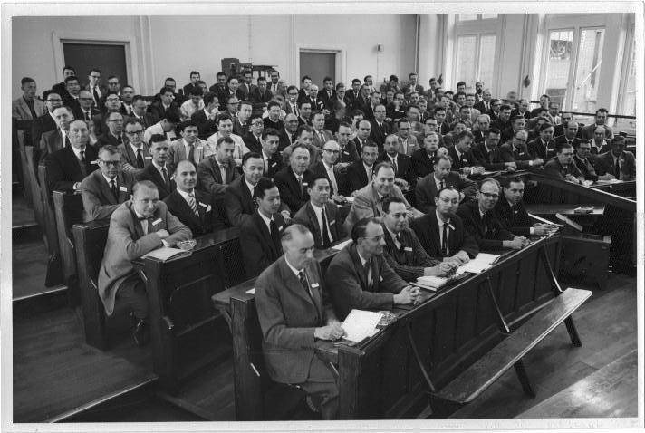

Slide 5
Broken symmetry in QFT?
The BCS “gauge problem”, 1958 : race to solution (Nambu, Bogoliubov and Shirkov, PWA)—(interlude with KGB)
The Solution: Phys Rev 112, 1900, ‘58 (PWA) The gap is empty! (EXPERIMENT AGREES)--Goldstone bosons→third component of plasmon; lowest collective mode=Higgson to be (explain later)
1960 Nambu & Jona-Lasinio from BCS: gap = mass of nucleon, pion = Goldstone boson: mass from interactions

Slide 6
massless Fermions
holes
➔p
gap
electrons
p
superconductivity
gap = mass--Nambu

Slide 7
More broken symm in qft: 1962 and after
Consequence for BCS: Superconductors have no condensate: no”all-pervading field”--e g coupling to sound vanishes as q→0. Sondhi, Oganesyan, Hansson 2004--B-F theory, Δ a “topological order parameter”.
And phase transition at Tc is “x-y” type, occurs by proliferation of vortices in vortex liquid, which is observed in cuprates.
In ‘62 I began to hear rumors in Cambridge that “Goldstone” bosons were blocking progress with BS theories in QFT. (students, R Eden)
returned to Bell summer ‘62 (busy time: Josephson, flux flow & creep, phonon bumps) & talked to J G Taylor (visiting John Klauder)

Slide 8
Plasmons, Gauge Invariance and Mass: PR 130, 439 (1962)
2 gifts from John Taylor: a) it was a problem; b) mysterious paper by Schwinger(PR125,397) that didn’t mention broken symmetry but did say a gauge field need have no zero-mass photon.
So my paper starts out as mysterious as Schwinger, but ends up saying you CAN make mass a la Nambu, but your Goldstone boson disappears into the massive vector boson which results.
Neither I, nor Higgs, nor any of the other 5, actually mentioned the scalar Higgs in those first papers. We invented the W and Z, not the Higgs. The Higgs IS an “Anderson-Bogoliubov” mode in the superconductor.

Slide 9
Some Further Comments and Developments
Mass for the Higgson appeared first, as far as I can see, in Higgs’ 66 paper where he gave it mass (a la Mexican hat) by fiat. But it seems the “Mexican Hat” is a figment, an imaginary construct?!
I gave a lot of thought to observing the Higgs condensate. I was right in that I could see no way of doing so—it has no local meaning!—Is this relevant to the missing zero-point energy-which is why I gave up?
3 But of course—one observes the Higgs” field” by its effect of giving mass to everyone—just as the superconducting gap gaps the whole Fermi surface! I missed this, but should have seen it.
4 Littlewood & Varma (PR B26, 4883, 1982) found a Raman-active AB mode in NbSe2, which can be interpreted as Higgs-like. AB modes play a big role in He-3 (Leggett) but are NOT gapped there.

Slide 10
A very modern Problem in CMT
Two classes of superfluids
I: the liquid Heliums, 3&4: They have condensates, genuine local order parameters
II: superconductors, the Higgs. No local OP, only topological.
So--which is supersolid He4? (Yes, Virginia, it does really exist). There is strong evidence that the transition Tc is into a vortex liquid, not a normal state. Cold atom experiments on “Bose-Hubbard” model are suggestive--next slide.

Slide 11
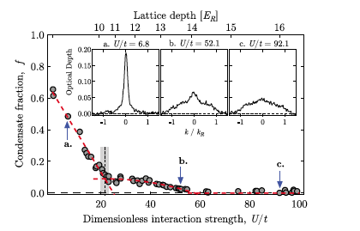
spielman et al, PRL 105, 110401, 2010

Slide 12
So while we wait with bated breath for new results on the Higgs, we can also expect surprises in ultracold physics--making it clearer than ever that it’s all one subject!
Thank you!

