Slide 1
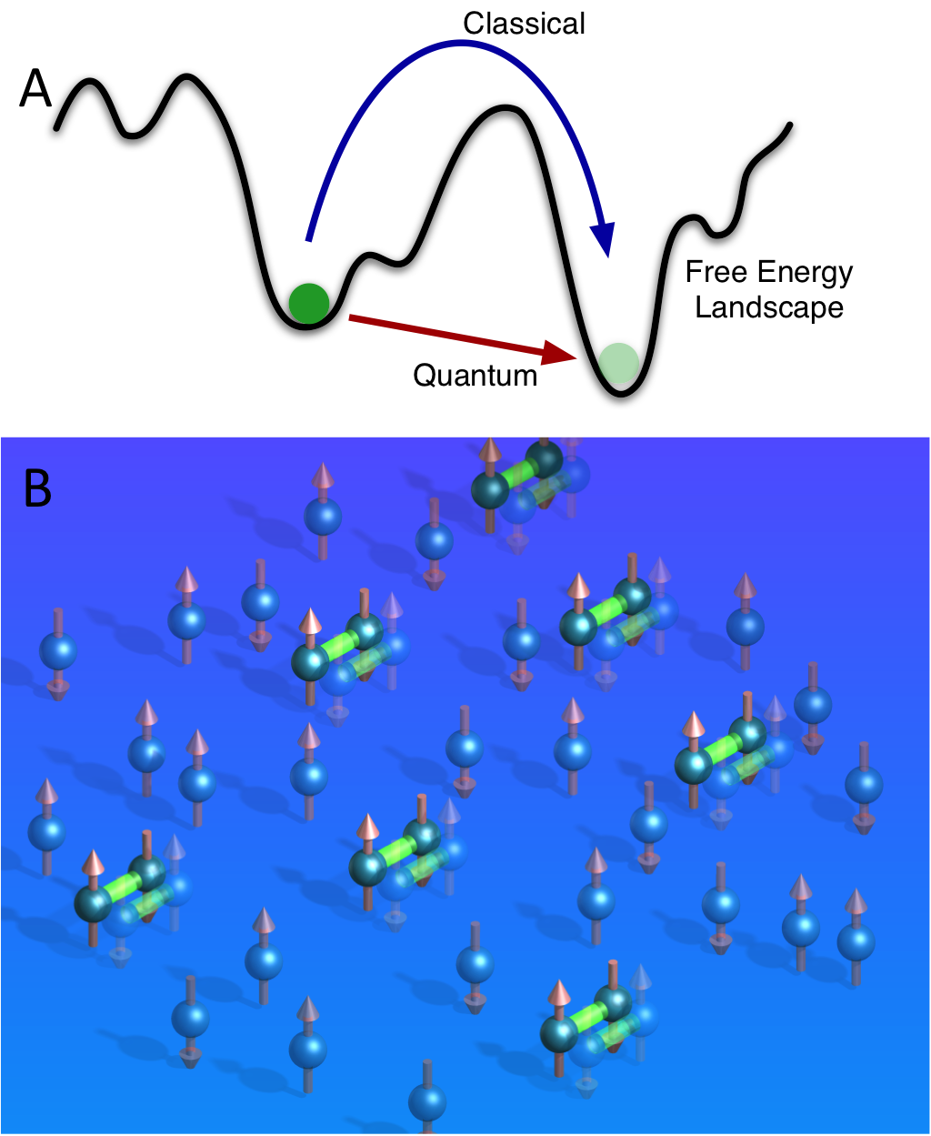
Quantum Annealing and Computation
Why Climb mountains when you can
…. Tunnel through them?
Applications: Circuit Design to Magnets to Protein Folding

Slide 2
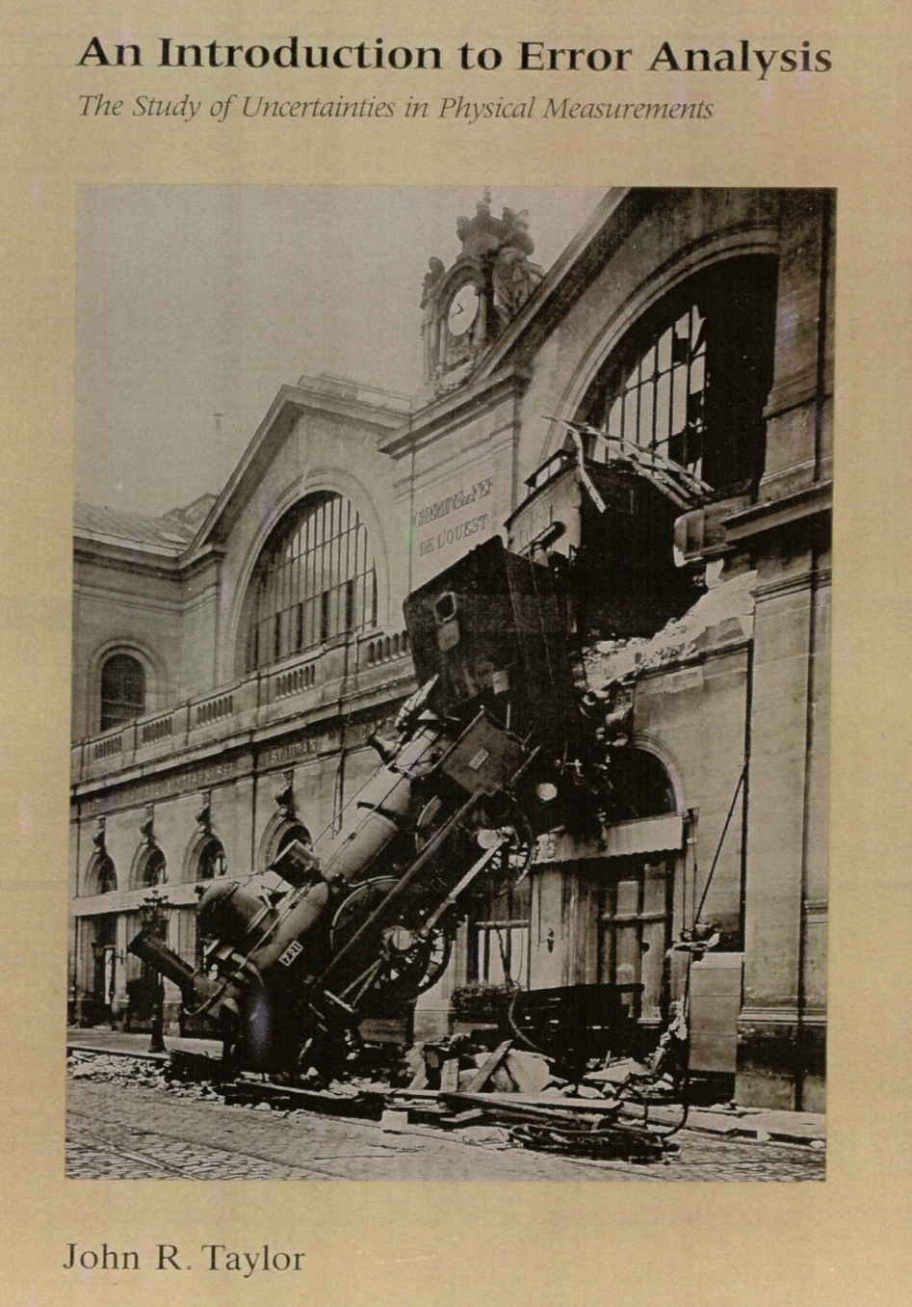
Brute
Force
Solution

Slide 3
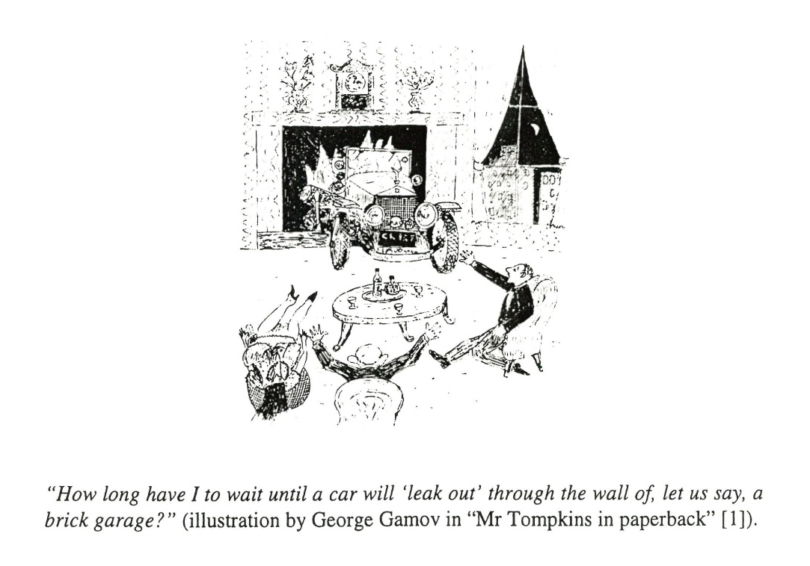

Slide 4
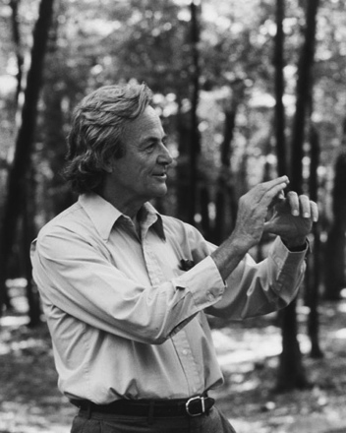
“And I'm not happy with all the analyses that go with just the classical theory, because nature isn't classical, dammit, and if you want to make a simulation of nature, you'd better make it quantum mechanical, and by golly it's a wonderful problem, because it doesn't look so easy.”
Richard P. Feynman

Slide 5
Process Flowchart
input
classical
process
quantum
process
output
printout
Feynmann’s
‘quantum’ computer

Slide 6
Process Flowchart
input
LiHo_{0.44}Y_{0.54}F₄
classical
process
quantum
process
classical
anneal
quantum
anneal
output
printout
Feynmann’s
‘quantum’ computer

Slide 7

OUTLINE
TWO STRANDS
(1) Particles as Waves
Tunneling
(2) Hard Problems
Circuit Boards, Proteins, Magnets
B. BRING TWO STRANDS TOGETHER
Quantum Speed-Up
Real Systems & Computer Algorithms
Thomas F. Rosenbaum

Slide 8
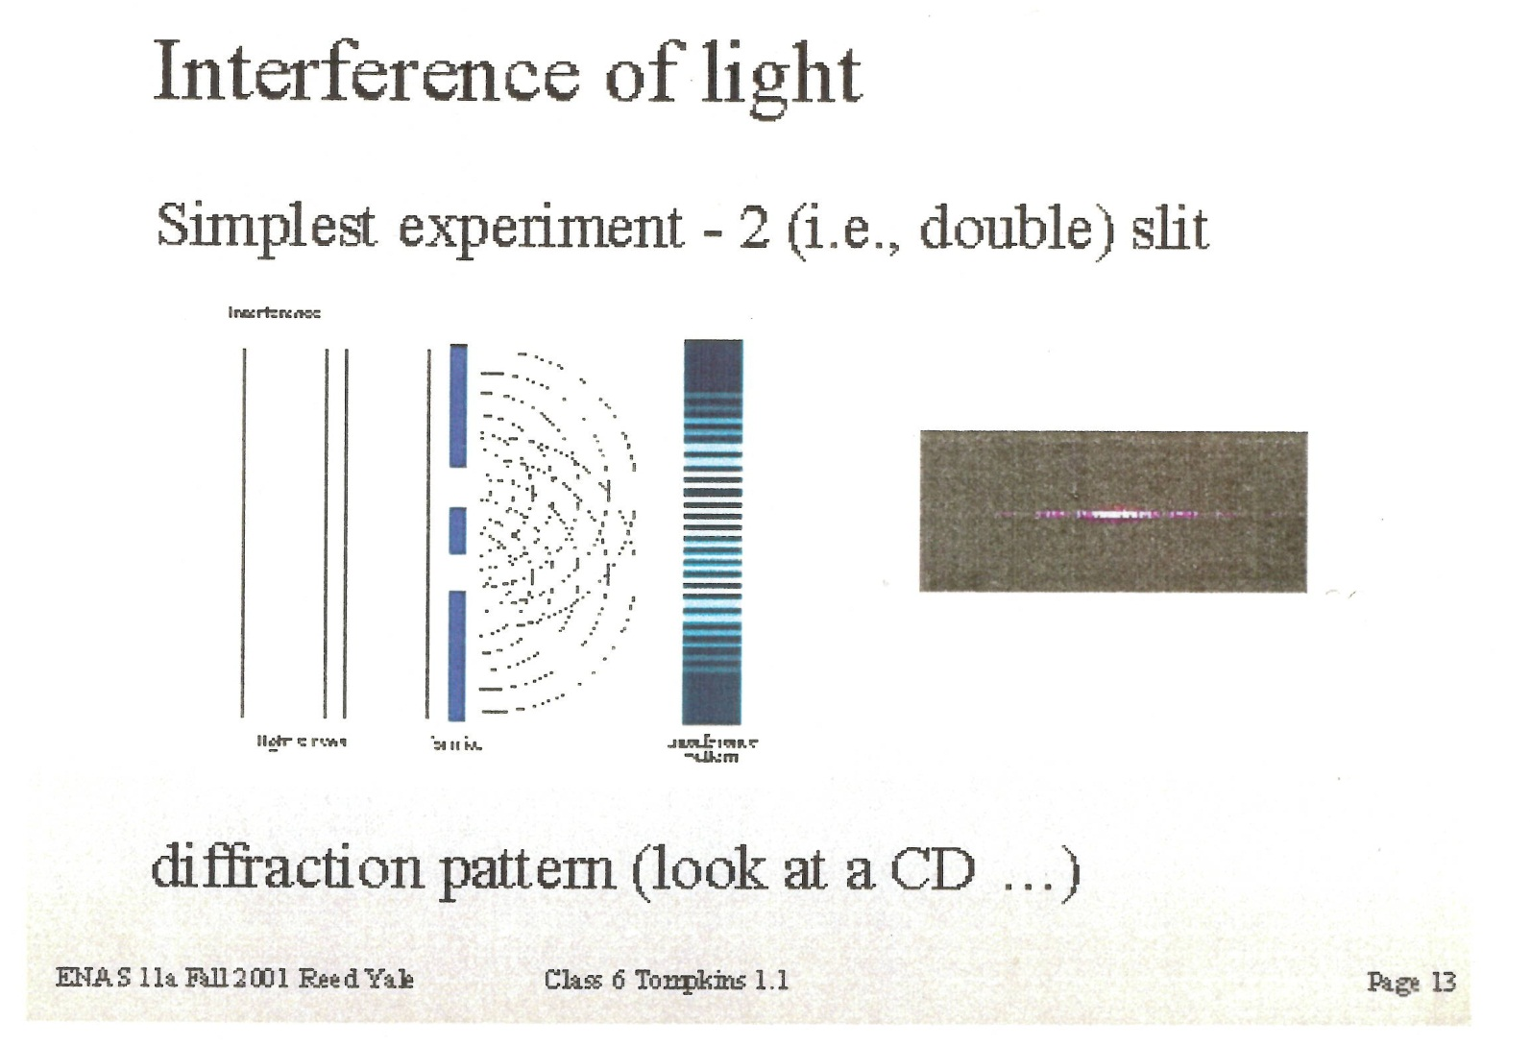

Slide 9
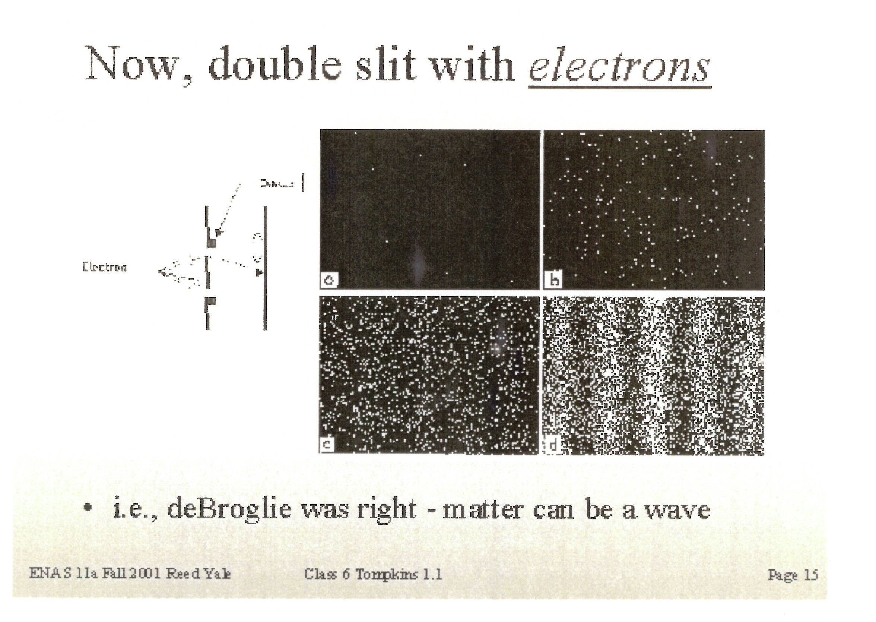

Slide 10
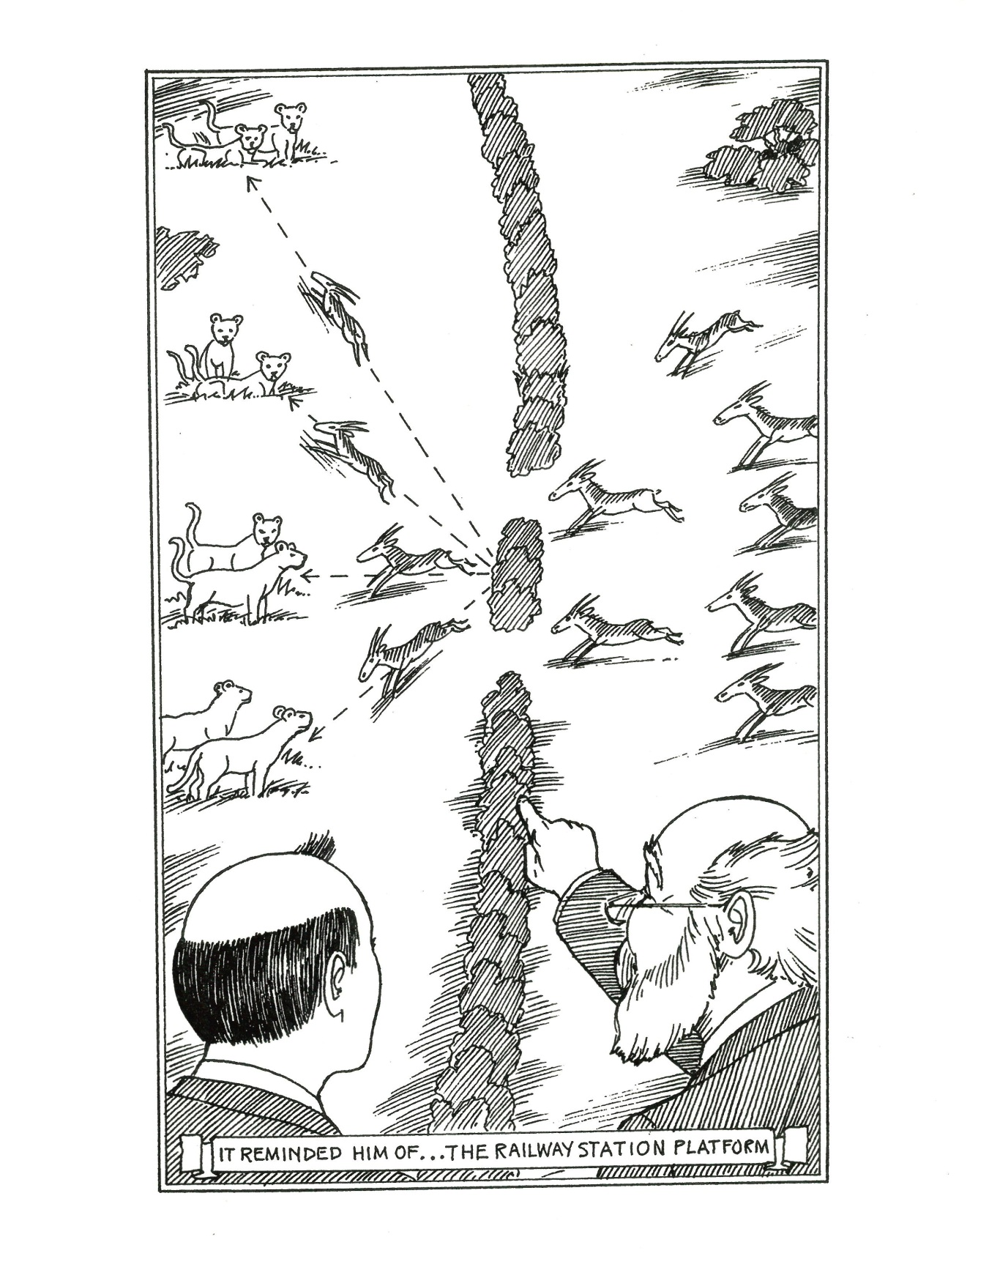

Slide 11

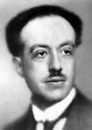
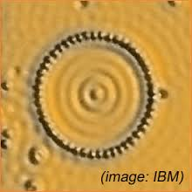
“Material particles possess wave and particle properties.” (1924)
Waves in a pond
Louis de Broglie
Electron waves in a metal
D. Eigler et al., 1993

Slide 12
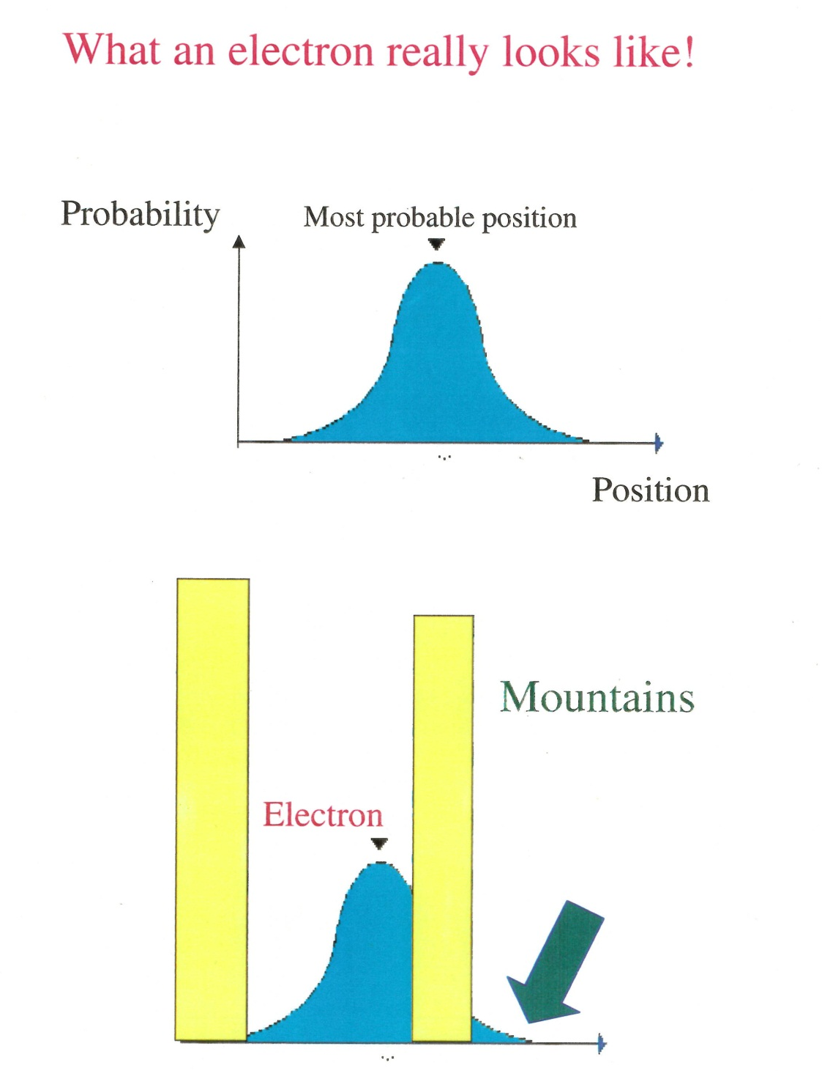

Slide 13
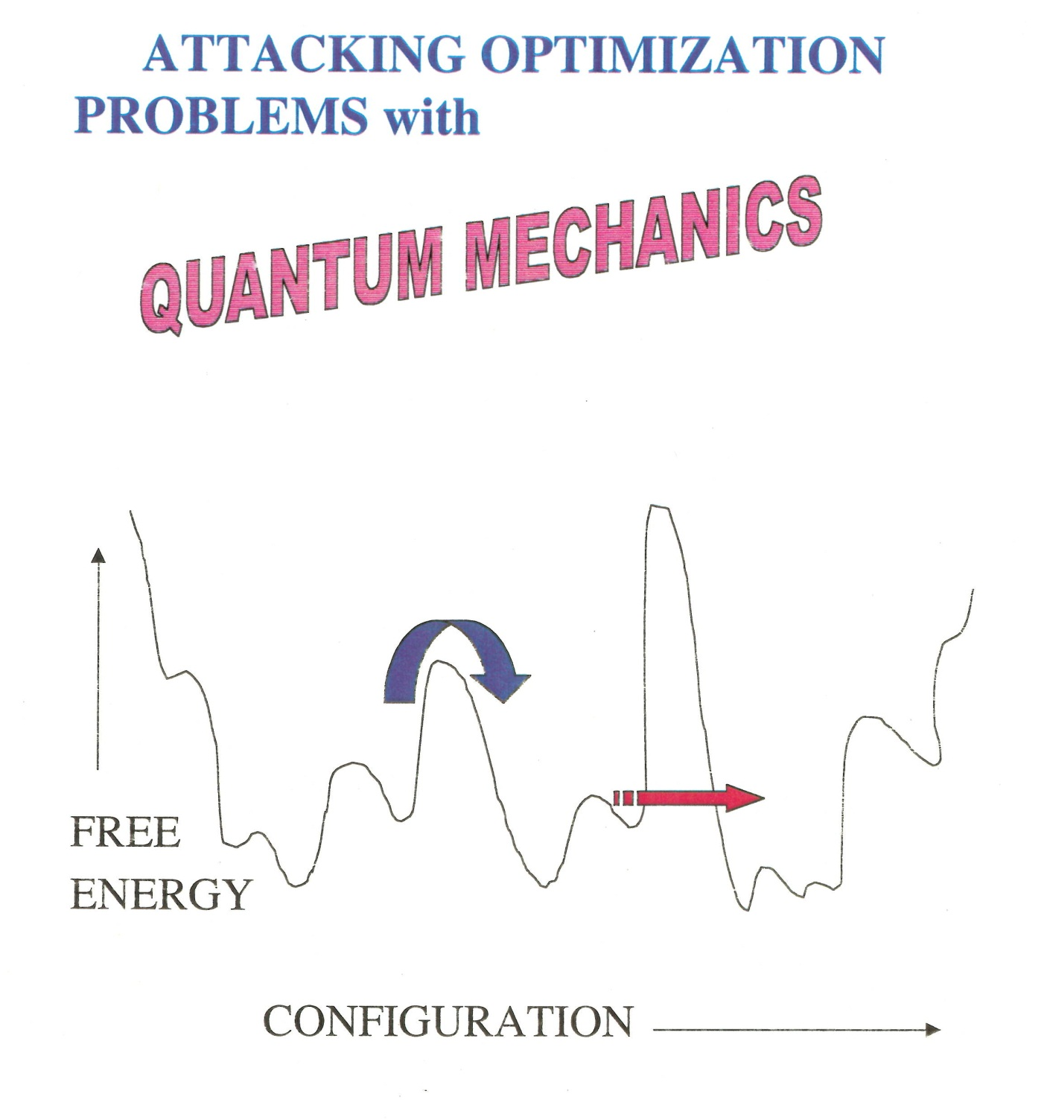

Slide 14
Traveling salesman

Slide 15
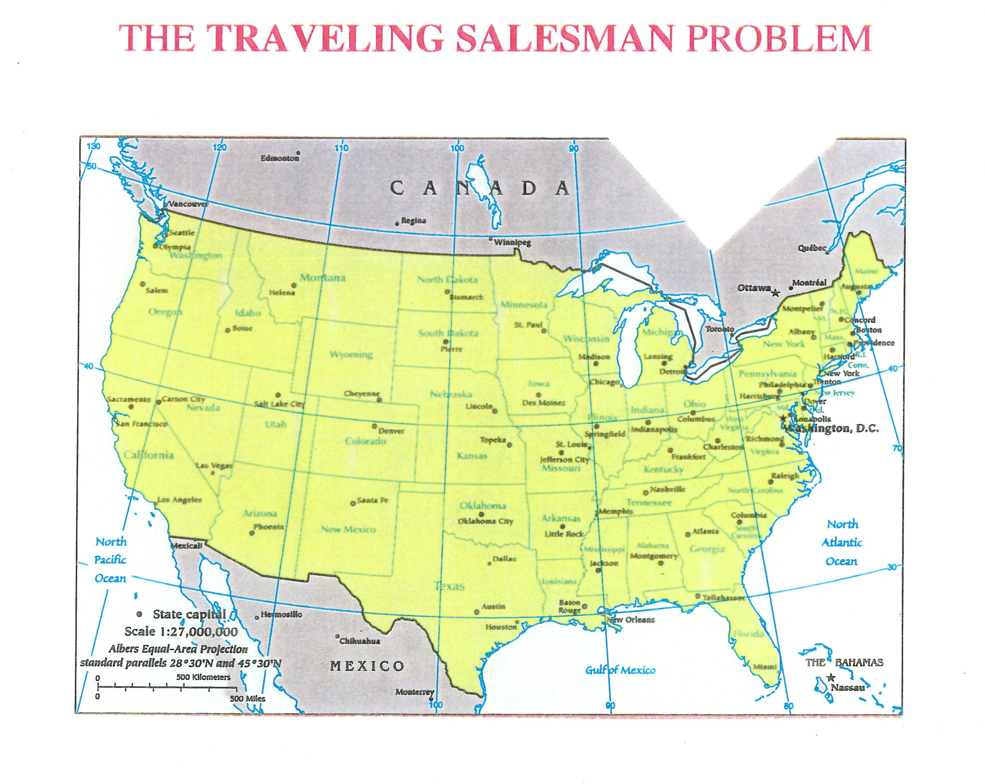

Slide 16
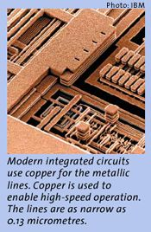
Circuit optimization

Slide 17
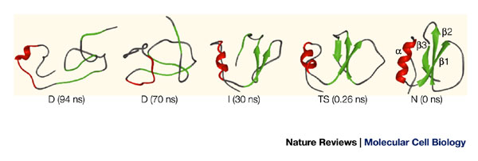
Protein Folding
Chymotrypsin inhibitor 2

Slide 18
Magnets: Interactions can be Simple
Ferromagnet
Anti-ferromagnet

Slide 19
Or, they can introduce Complexity…
DISORDER FM with some AFM Bonds
Why is the disordered magnet problem hard?

Slide 20
FRUSTRATION
or

Slide 21
OUTLINE
TWO STRANDS
(1) Particles as Waves
Tunneling
(2) Hard Problems
Circuit Boards, Proteins, Magnets
B. BRING 2 STRANDS TOGETHER
Quantum Speed-Up
Real Systems & Computer Algorithms

Slide 22
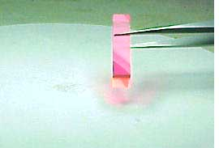
Li(Ho,Y)F₄

Slide 23
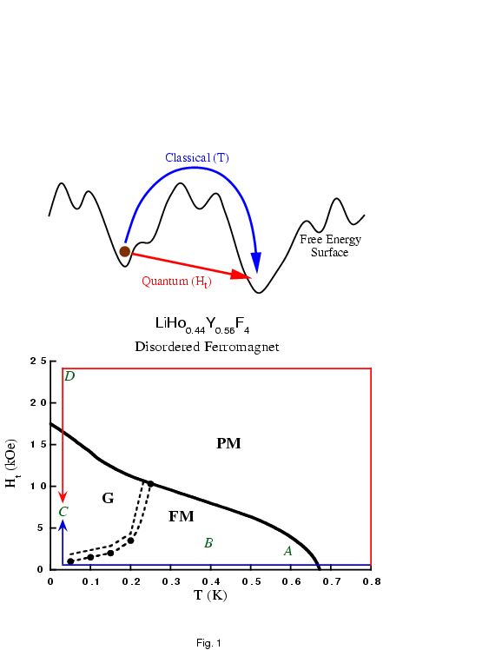
Quantum and
Classical “Algorithms”

Slide 24
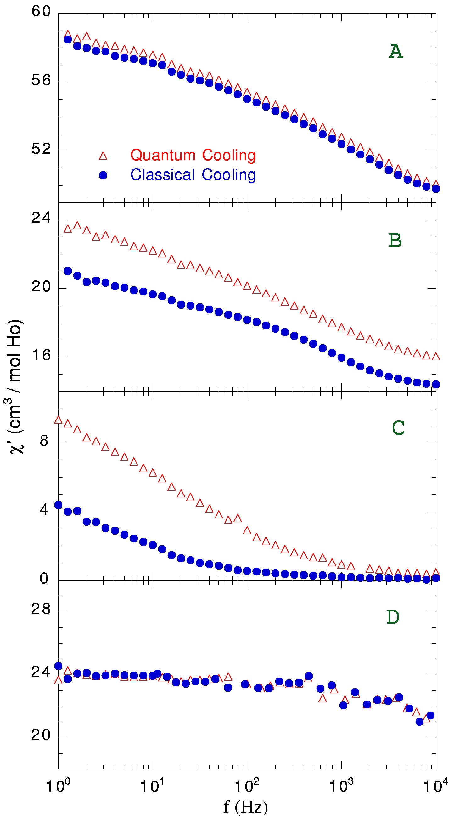
Fluctuation Response
Notes:
Difference really kicks in deep in the buried phase.
“Microscopic” response kicking in.

Slide 25
Quantum Speed-Up
quantum

Slide 27
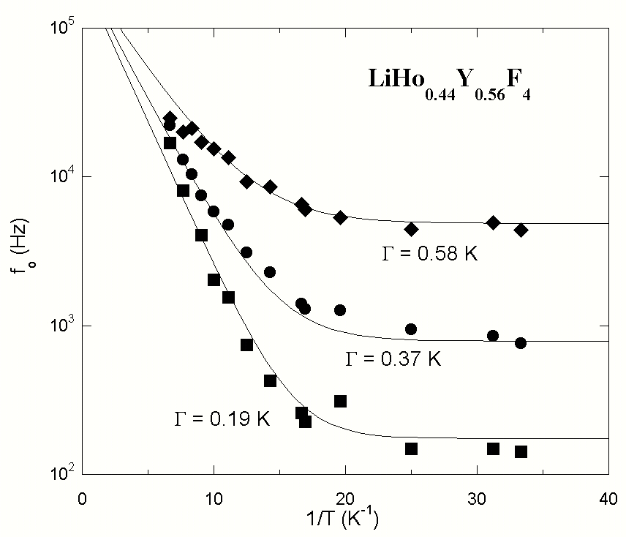
Quantum Tunneling with the numbers

Slide 28
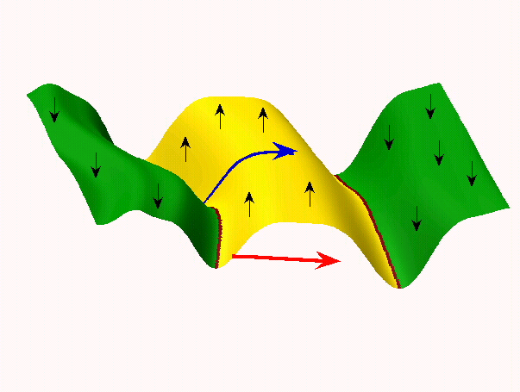
It Pays to Look for Quantum Channels!

Slide 29
Relation to‘conventional’ quantum computation
coherent region – computes as
if gate-based
total system-evolves
incoherently

Slide 30
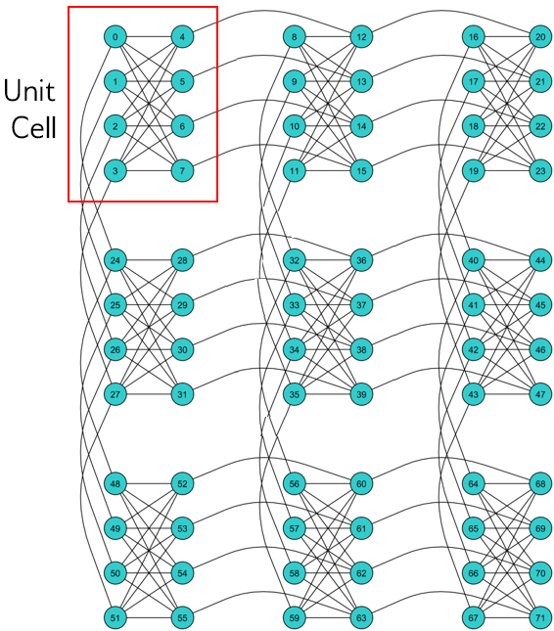
Programmable QuBit Architecture:
D-Wave Systems
A 3x3 Chimera graph. Qubits are arranged in 9 cells.

Slide 31
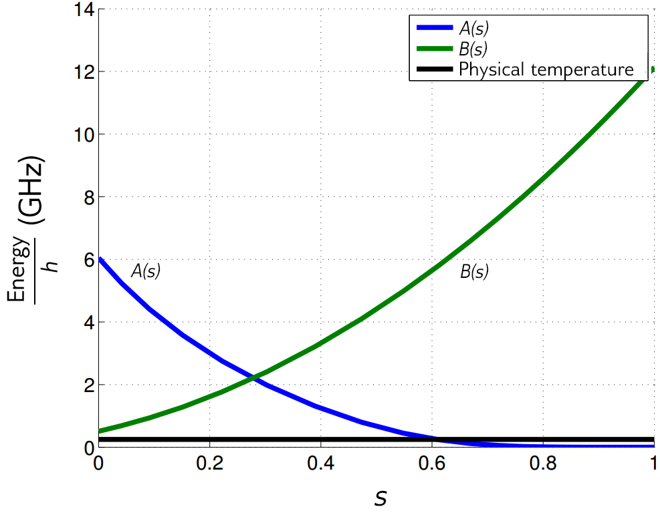
Programmable Quantum Annealing:
D-Wave Systems (2X)
Annealing functions
A(s), B(s).

Slide 32
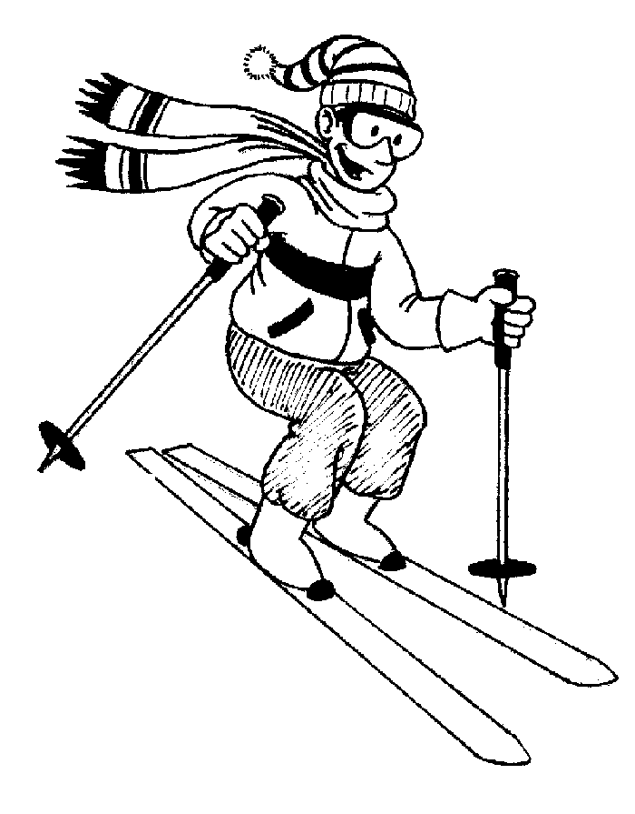
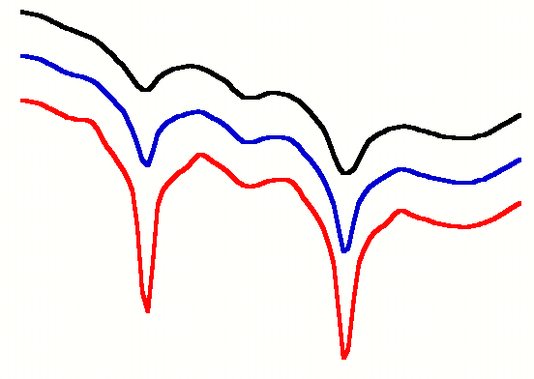

Free Energy as T Decreases
Free
Energy
T_{high}
T_{low}

Slide 33
Free
Energy
T_{high}
T_{low}

Slide 34
Quantum Spin Clusters
LiHo_{0.045}Y_{0.955}F₄

Slide 35
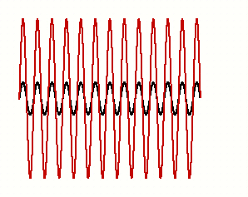
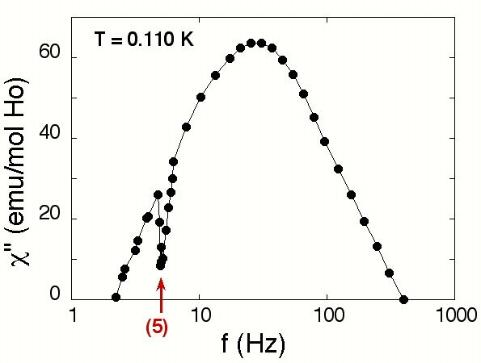
Encoding Information
pump
probe
Labeled by frequency

Slide 36
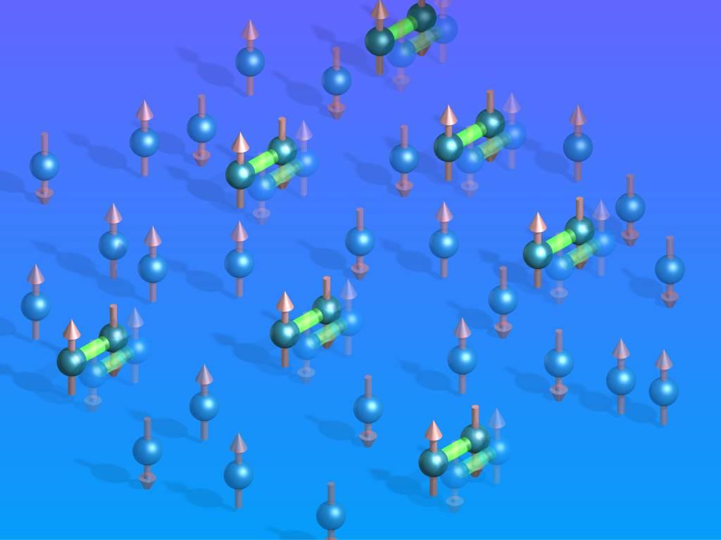

Slide 37
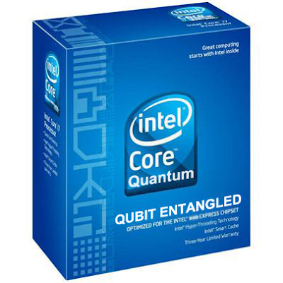
Soon to be a
commercial product!

Slide 38
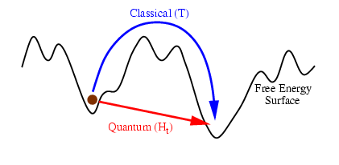
Summary
Tunneling gets you from here to there faster
Quantum annealing allows the search of different minima (configurations) than thermal annealing
New approaches to computing and maybe even Feynman’s quantum computer

Slide 39
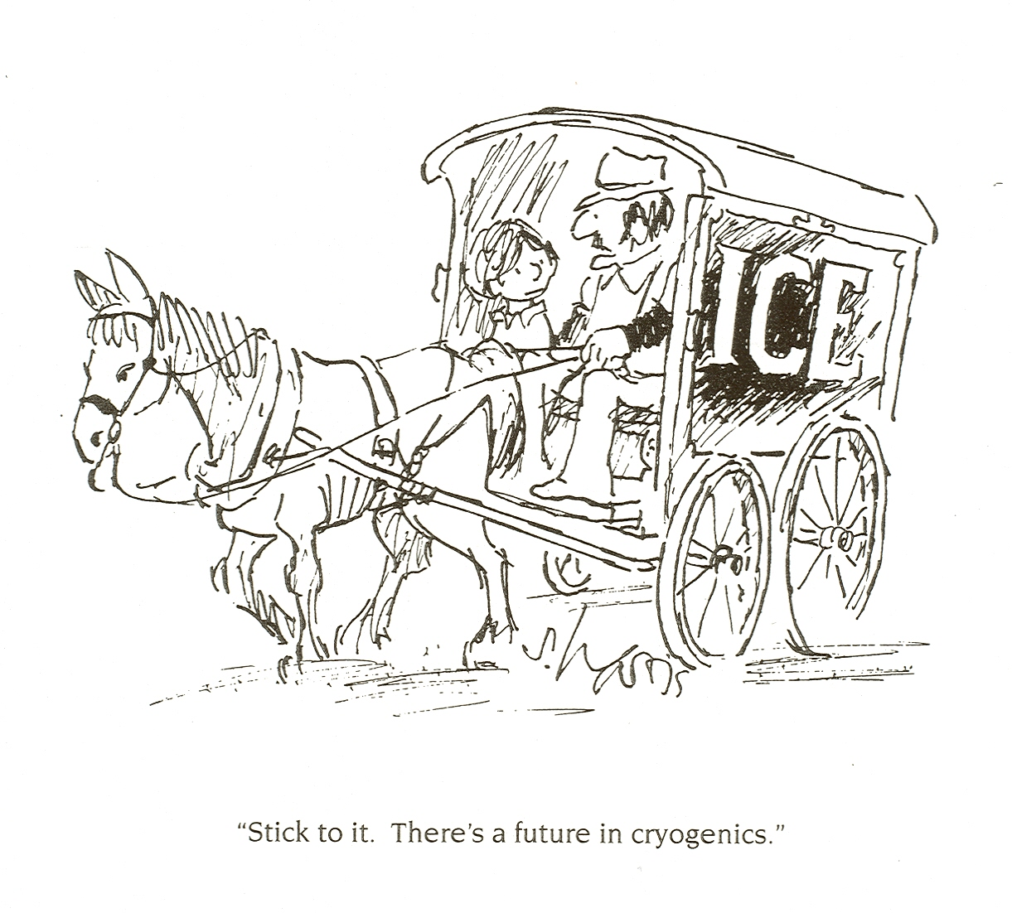
D. Bitko, J. Brooke, S. Ghosh, M. Schmidt (UChicago);
G. Aeppli (ETH); D. Silevitch, C. Tang, T.F. Rosenbaum (Caltech).
M.A. Schmidt, D.M. Silevitch, G. Aeppli, and T.F. Rosenbaum, PNAS 111, 3689 (2014).
D.M. Silevitch, C. Tang, G. Aeppli, and T.F. Rosenbaum, Nature Commun. DOI: 10.1038/s41467-019-11985-1 (2019).

