Slide 1
QCP for stripe order : An organizing principle of cuprates
Louis Taillefer
University of Sherbrooke
Canadian Institute for Advanced Research
Doiron-Leyraud & Taillefer, arXiv:1204.0490
Taillefer, Annual Review of CMP 1, 51 (2010)
arXiv:1003.2972

Slide 2
Collaborators
Measurements
Sherbrooke N. Doiron-Leyraud
J. Chang, R. Daou, E. Hassinger, F. Tafti
O. Cyr-Choinière, S. Dufour-Beauséjour, G. Grissonnanche,
F. Laliberté, D. LeBoeuf, S. René de Cotret
Grenoble K. Behnia, L. Malone, I. Sheikin
Toulouse C. Proust, B. Vignolle
Tallahassee L. Balicas, J. Y. Jo, J.-H. Park
Samples
YBCO UBC D. Bonn, W. Hardy, R. Liang, B. Ramshaw
Eu-LSCO Tokyo S. Pyon, H. Takagi, T. Takayama, Y. Tanaka
Nd-LSCO Texas J.-G. Cheng, J. B. Goodenough, J.-Q. Yan, J.-S. Zhou
Hg-1201 Minneapolis N. Barisic, M. Greven

Slide 3
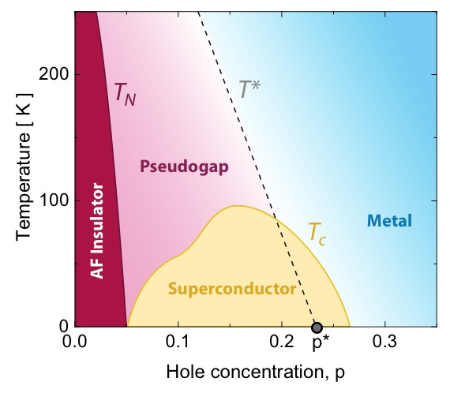
Cuprate superconductors
Questions
Pairing ?
T_{c} dome ?
Linear-T resistivity ?
Quantum critical point ?
Pseudogap phase ?
Taillefer, Annual Review of CMP 1, 51 (2010) – arXiv:1003.2972

Slide 4
Organizing principle
Quantum critical point for SDW order
Features
Quantum critical point (QCP)
Spin-density-wave (SDW) order
Fermi-surface reconstruction (FSR)
Linear-T resistivity (A)
Superconductivity – T_{c} dome
A ~ T_{c}
Doiron-Leyraud & Taillefer, arXiv:1204.0490

Slide 5
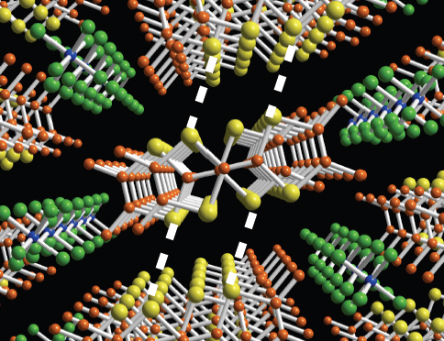
The Archetype (TMTSF)₂PF₆
Organic superconductor
Doiron-Leyraud et al., PRB 80, 214531 (2009)

Slide 6
The Archetype (TMTSF)₂PF₆
QCP for SDW order
Quantum critical point (QCP)
Spin-density-wave (SDW) order
Fermi-surface reconstruction (FSR)
Linear-T resistivity (A)
T_{c} dome
A ~ T_{c}
Questions
Pairing ?
T_{c} dome ?
Linear-T resistivity ?
Quantum critical point ?
Pseudogap phase ?
Answers
AF spin fluctuations
Phase competition
SF + Pairing correlations
SDW order

Slide 7
QCP principle : examples
Organic superconductors (TMTSF)₂X X = PF₆ , ClO₄
Electron-doped cuprates PCCO & LCCO
Iron-based superconductors Co-BaFe₂As₂ & P-BaFe₂As₂
Hole-doped cuprate Nd-LSCO

Slide 8
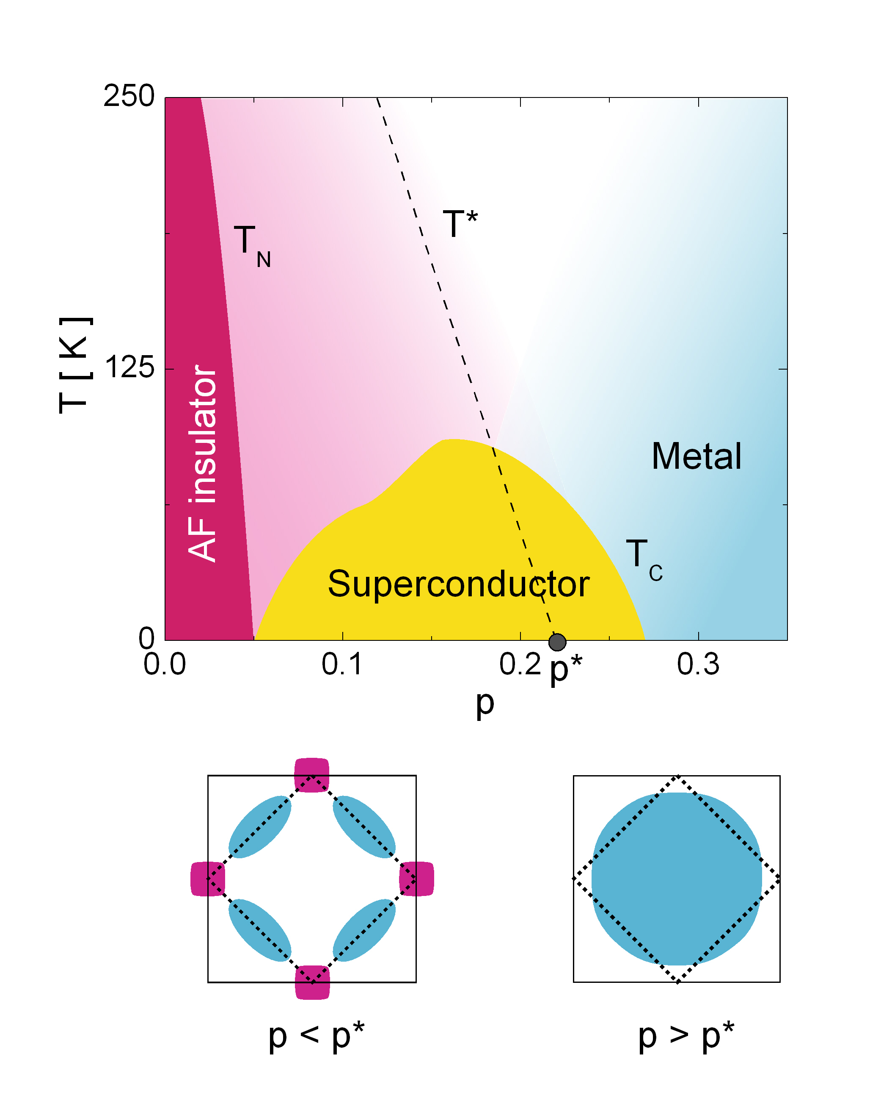
Electron-doped cuprates PCCO & LCCO
Hall
QCP for SDW order
Quantum critical point (QCP)
Spin-density-wave (SDW) order
Fermi-surface reconstruction (FSR)
Linear-T resistivity (A)
T_{c} dome
A ~ T_{c}
Dagan et al., PRL 2004
Jin et al., Nature 2011

Slide 9
Iron-based superconductors BaFe₂As₂
QCP for SDW order
Quantum critical point (QCP)
Spin-density-wave (SDW) order
Fermi-surface reconstruction (FSR)
Linear-T resistivity (A)
T_{c} dome
A ~ T_{c}
Doiron-Leyraud et al., PRB 80, 214531 (2009)

Slide 10
Iron-based superconductors BaFe₂As₂
P-doped BaFe₂As₂
QCP for SDW order
Quantum critical point (QCP)
Spin-density-wave (SDW) order
Fermi-surface reconstruction (FSR)
Linear-T resistivity (A)
T_{c} dome
A ~ T_{c}
Nakai et al., PRB 2010

Slide 11
Iron-based superconductors BaFe₂As₂
Pseudogap phase
Onset above T_{N}
Nematic character
FSR
Upturn in Co-Ba122
Downturn in K-Ba122
QCP for SDW order
Quantum critical point (QCP)
Spin-density-wave (SDW) order
Fermi-surface reconstruction (FSR)
Linear-T resistivity (A)
T_{c} dome
A ~ T_{c}
Chu et al., Science 2010

Slide 12
Iron-based superconductors BaFe₂As₂
Pseudogap phase
Onset above T_{N}
Nematic character
FSR
Upturn in Co-Ba122
Downturn in K-Ba122
QCP for SDW order
Quantum critical point (QCP)
Spin-density-wave (SDW) order
Fermi-surface reconstruction (FSR)
Linear-T resistivity (A)
T_{c} dome
A ~ T_{c}

Slide 13
Iron-based superconductors QCP principle
QCP for spin-stripe order
Quantum critical point
Stripe order
Fermi-surface reconstruction
Linear-T resistivity
T_{c} dome
A ~ T_{c}
+ Precursor nematic regime

Slide 14
Hole-doped cuprate Nd-LSCO
QCP for stripe order
Quantum critical point
Stripe order
Fermi-surface reconstruction
Linear-T resistivity
T_{c} dome
A ~ T_{c}
Pseudogap phase
Onset above T_{CO}
Daou et al., Nature Physics 2009

Slide 15
QCP principle
CUPRATE
ORGANIC
PNICTIDE
Taillefer, Annual Review of CMP 1, 51 (2010) – arXiv:1003.2972

Slide 16
Hole-doped cuprates

Slide 17
Pnictides QCP principle
QCP for spin-stripe order
Quantum critical point
Spin-stripe order
Fermi-surface reconstruction
Precursor nematic regime
Linear-T resistivity
A ~ T_{c}
T_{c} dome

Slide 18
Hole-doped cuprates QCP principle
QCP for stripe order
Quantum critical point
Stripe order
Fermi-surface reconstruction
Precursor nematic regime
Linear-T resistivity
A ~ T_{c}
T_{c} dome

Slide 19
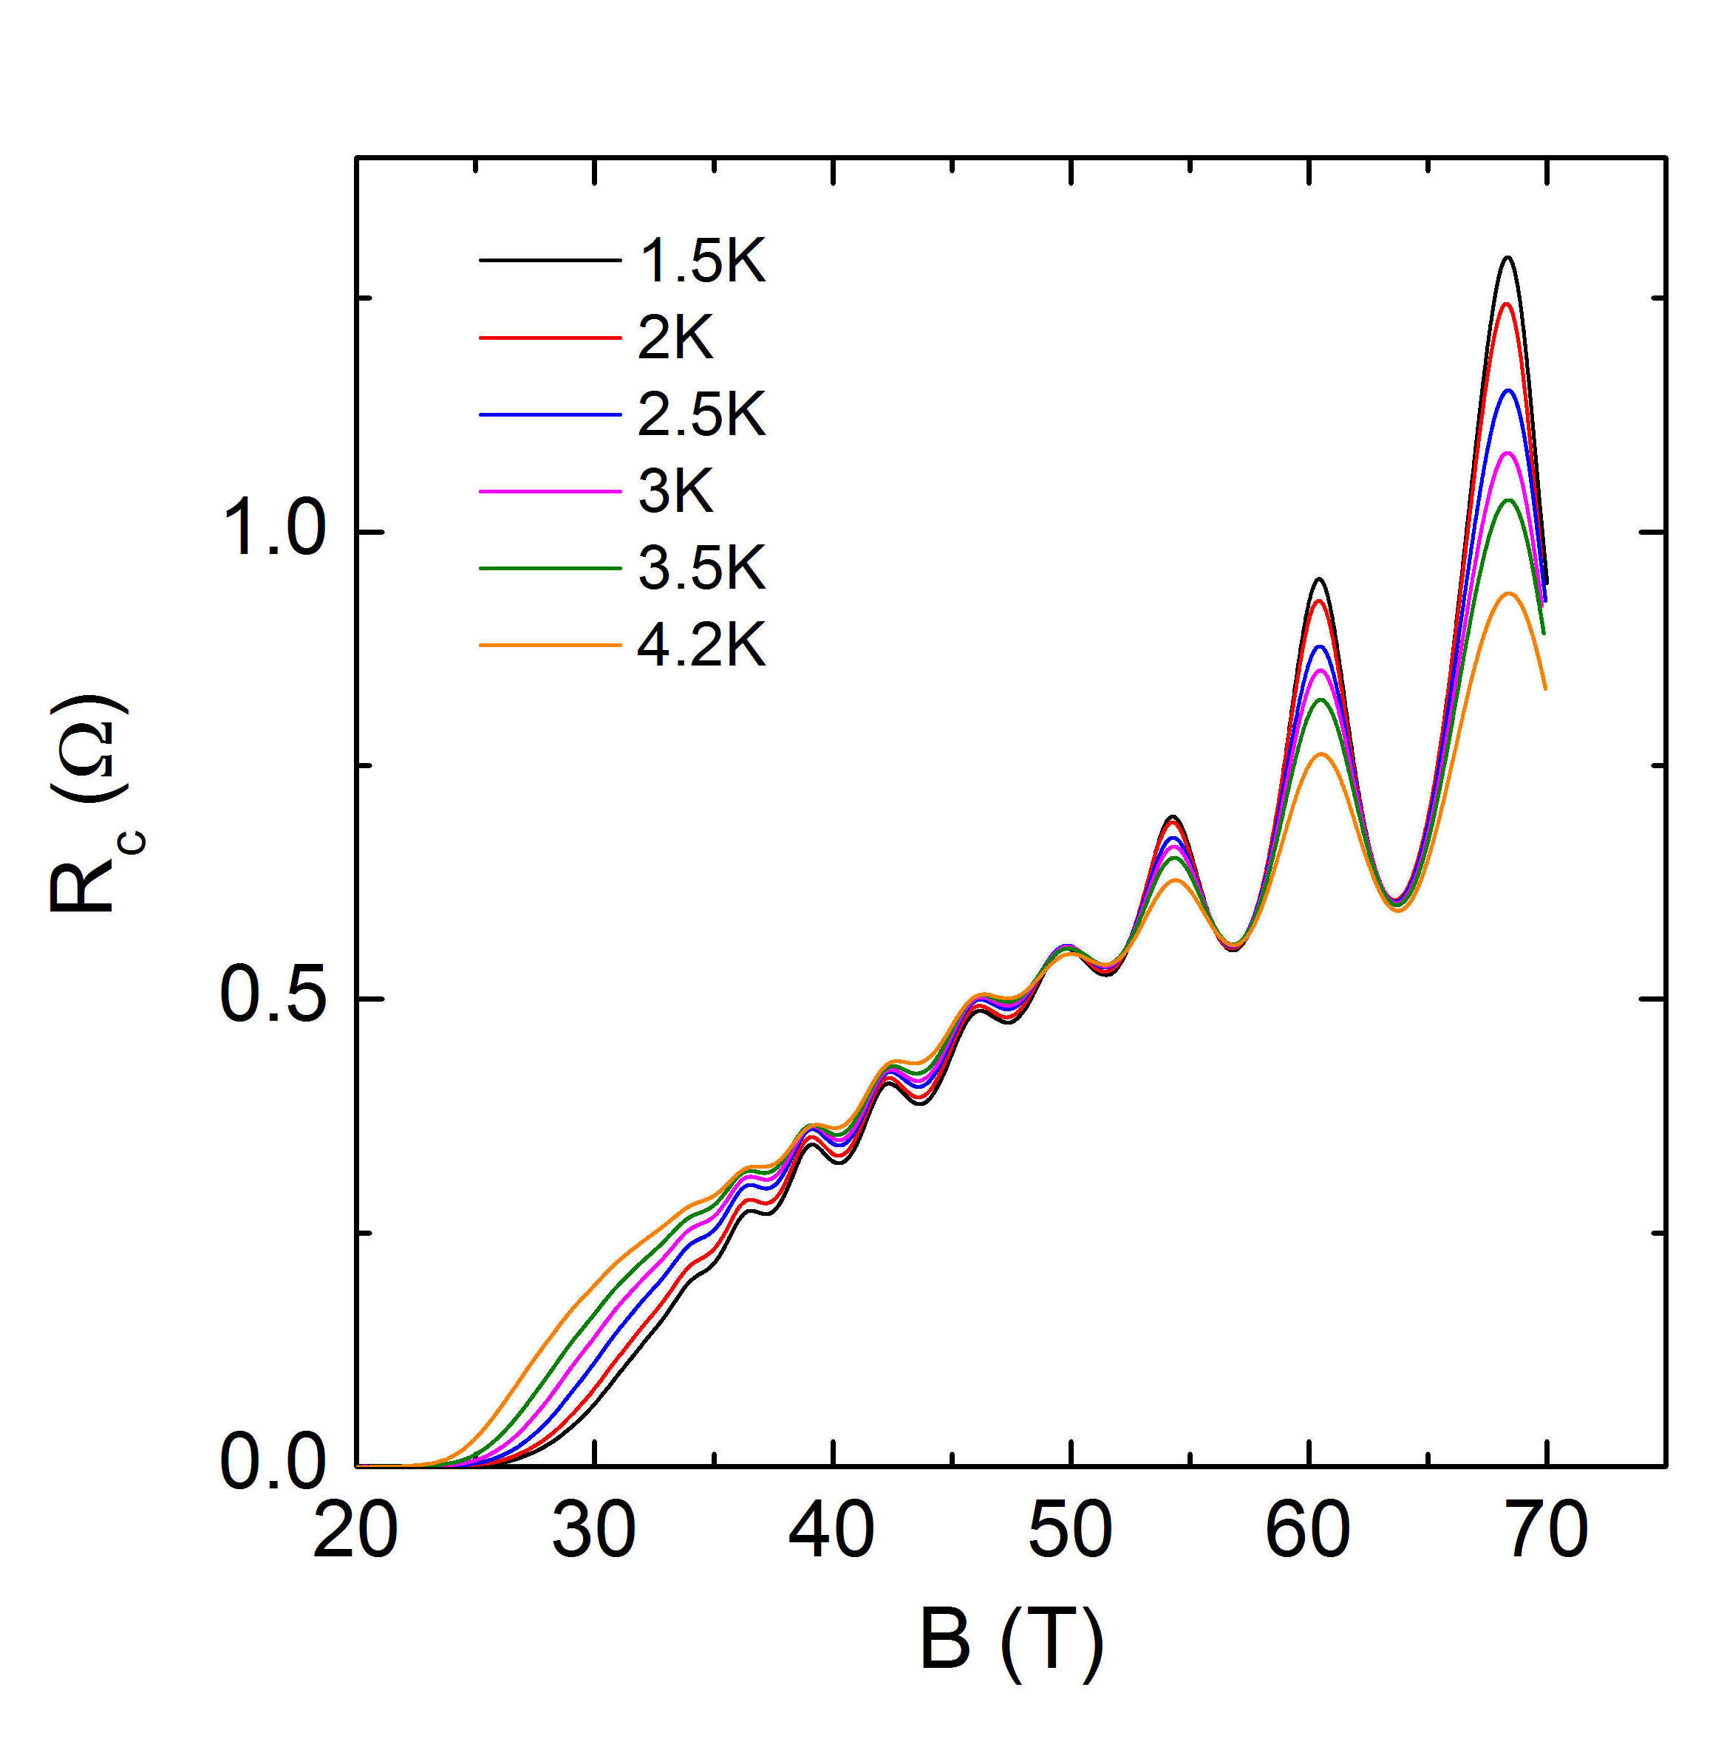
Hole-doped cuprates QCP & FSR
Quantum oscillations
Hall & Seebeck coefficients
Toulouse
Toulouse
Tallahassee
Grenoble
Doiron-Leyraud et al., Nature 2007
UD: small electron pocket
LeBoeuf et al., Nature 2007
Laliberté et al., Nature Comm. 2011

Slide 20
Hole-doped cuprates QCP & FSR
Hall & Seebeck coefficients
Toulouse
Tallahassee
Grenoble
UD: small electron pocket
OD: large hole pocket
QCP in between
LeBoeuf et al., Nature 2007
Laliberté et al., Nature Comm. 2011

Slide 21
Hole-doped cuprates QCP principle
QCP for stripe order
Quantum critical point
Stripe order
Fermi-surface reconstruction
Precursor nematic regime
Linear-T resistivity
A ~ T_{c}
T_{c} dome

Slide 22
Hole-doped cuprates Stripe order
Seebeck coefficient
YBCO
Eu-LSCO
X-ray: Fink et al., PRB 2011
NMR: Wu et al., Nature 2011
Stripe order is universal in hole-doped cuprates
Doiron-Leyraud & Taillefer, arXiv:1204.0490
Laliberté et al., Nature Comm. 2, 432 (2011)

Slide 23
Hole-doped cuprates QCP principle
QCP for stripe order
Quantum critical point
Stripe order
Fermi-surface reconstruction
Precursor nematic regime
Linear-T resistivity
A ~ T_{c}
T_{c} dome

Slide 24
Hole-doped cuprates Pseudogap phase
T* from resistivity
Doiron-Leyraud & Taillefer, arXiv:1204.0490

Slide 25
Hole-doped cuprates Pseudogap phase
Nernst coefficient
Pseudogap phase = Nematic regime
Daou et al., Nature 463, 519 (2010)
LeBoeuf et al., PRB 83, 054056 (2011)
Doiron-Leyraud & Taillefer, arXiv:1204.0490

Slide 26
Hole-doped cuprates QCP principle
QCP for stripe order
Quantum critical point
Stripe order
Fermi-surface reconstruction
Precursor nematic regime
Linear-T resistivity
A ~ T_{c}
T_{c} dome

Slide 27
Hole-doped cuprates Linear-T resistivity
Resistivity
Linear-T resistivity is universal in hole-doped cuprates
N. Doiron-Leyraud et al., arXiv:0905.0964

Slide 28
Hole-doped cuprates QCP principle
QCP for stripe order
Quantum critical point
Stripe order
Fermi-surface reconstruction
Precursor nematic regime
Linear-T resistivity
A ~ T_{c}
T_{c} dome

Slide 29
Hole-doped cuprates Linear-T resistivity
Resistivity
N. Doiron-Leyraud et al., arXiv:0905.0964
Cooper et al., Science 2009
Correlation between linear-T resistivity and T_{c}
L. Taillefer, Annual Review of CMP 1, 51 (2010) – arXiv:1003.2972

Slide 30
Hole-doped cuprates QCP principle
QCP for stripe order
Quantum critical point
Stripe order
Fermi-surface reconstruction
Precursor nematic regime
Linear-T resistivity
A ~ T_{c}
T_{c} dome

Slide 31
Hole-doped cuprates T_{c} suppression
SC fluctuations
via Nernst signal above T_{c}
H_{c2} decreases with underdoping
Decrease is non-monotonic : Stripe order
J. Chang et al., unpublished

Slide 32
Hole-doped cuprates QCP principle
QCP for stripe order
Quantum critical point
Stripe order
Fermi-surface reconstruction
Precursor nematic regime
Linear-T resistivity
A ~ T_{c}
T_{c} dome

Slide 33
Hole-doped cuprates Summary
QCP for stripe order
Quantum critical point
Stripe order
Fermi-surface reconstruction
Precursor nematic regime
Linear-T resistivity
A ~ T_{c}
T_{c} dome
Doiron-Leyraud & Taillefer, arXiv:1204.0490

Slide 34
The QCP principle – a universal scenario ?
ORGANIC
PNICTIDE
e-DOPE CUPRATE
h-DOPED CUPRATE

Slide 35
Thank you.
Doiron-Leyraud & Taillefer, arXiv:1204.0490
Taillefer, Annual Review of CMP 1, 51 (2010)
arXiv:1003.2972

