Slide 1
Outline: Part 2
What about 2D?
  Area laws for MPS, PEPS, trees, MERA, etc…
  MERA in 2D, fermions
Some current directions
  Free fermions and violations of the area law
  Monte Carlo with tensor networks
  Time evolution, etc…

Slide 2
Two dimensional systems
=

Slide 3
Two Dimensional Systems
Short range entanglement leads to area law of entropy entanglement
However, polynomial-scaling correlations do not require a logarithmic violation of the area law!

Slide 4
Locally correlated and entangled: Non-critical
Some critical systems
Free fermions and critical systems (usually a 1D Fermi surface)

Slide 5
MPS/DMRG
1D structure on a 2D lattice:

Slide 6
PEPS
Natural 2D structure, clearly obeys

Slide 7
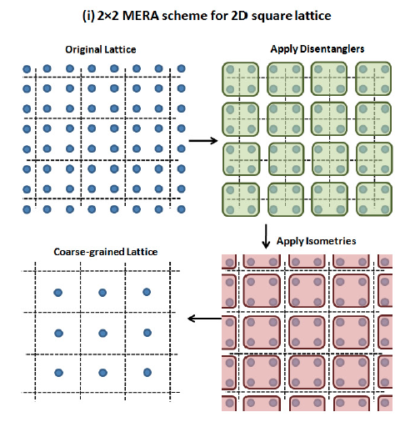
2D MERA
MERA naturally extends to two-dimensions
What about entanglement entropy?
Evenbly & Vidal, Phys. Rev. B 79, 144108 (2009)

Slide 8
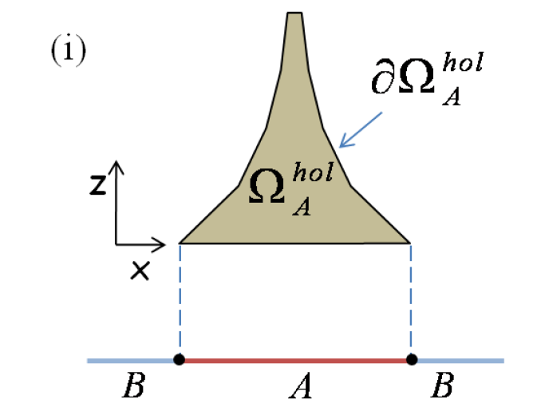
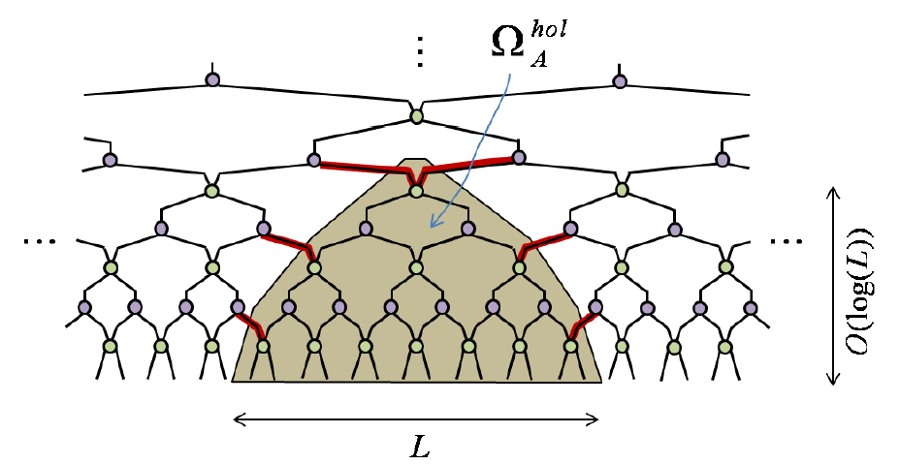
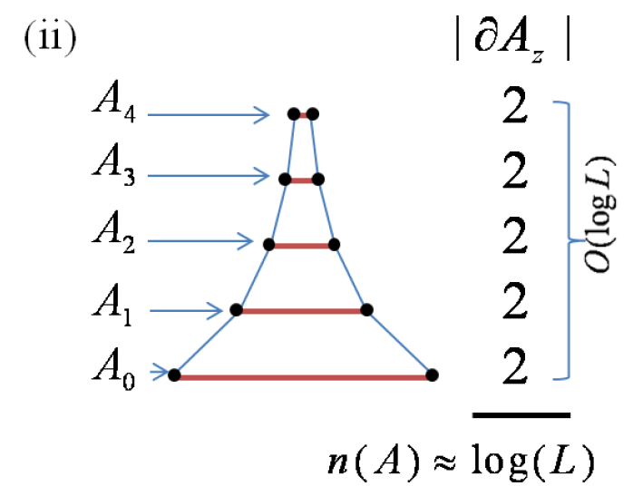
Entanglement in 1D MERA
Each layer contains 2 more legs, total of
legs, meaning .
Evenbly & Vidal, J Stat Phys (2011) 145:891-918

Slide 9
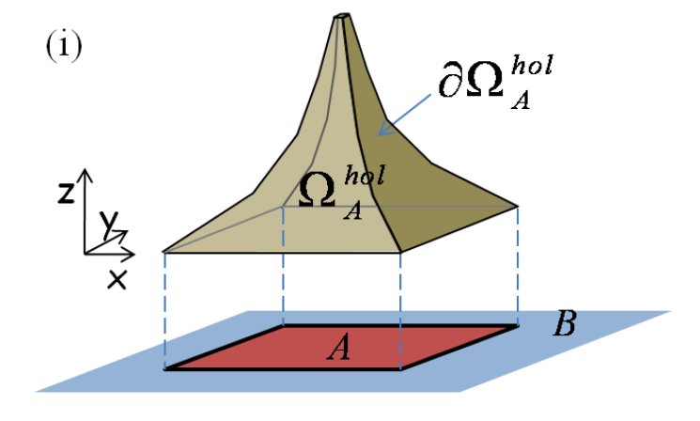
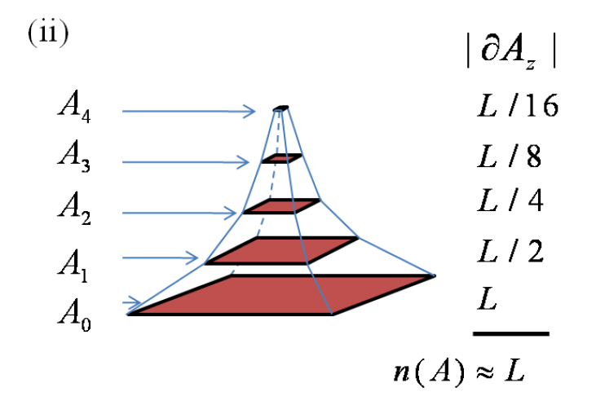
Entanglement in 2D MERA
The th layer contributes legs. In total, less than legs, so .
Evenbly & Vidal, J Stat Phys (2011) 145:891-918

Slide 10
Scale-invariant 2D MERA
One can still represent scale-invariance with 2D MERA with correlations that decay polynomially.
Similarly, PEPS states can have this property too.

Slide 11
Fermions in 2D
Fermi liquid have logarithmic
violation of the area law, so
will not work as well for these.
But fermionic systems can be in
less entangled phases (e.g. Mott
insulator, etc).
However, terms in the Hamiltonian anti-commute. Need to keep track of some artificial ordering of the sites for bookkeeping.
Energy
Fermi level
Momentum

Slide 12
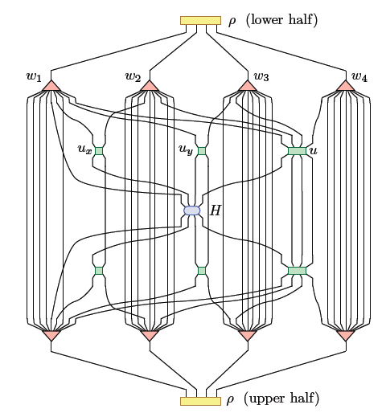
Flattened tensor network
Basically re-ording
the sites. Will get
minus signs for
every fermion that
is moved past
another.
Minus sign when an odd number of fermions are moved past an odd number of fermions: keep track of parity
Corboz & Vidal
Phys. Rev. B 80, 165129 (2009)

Slide 13
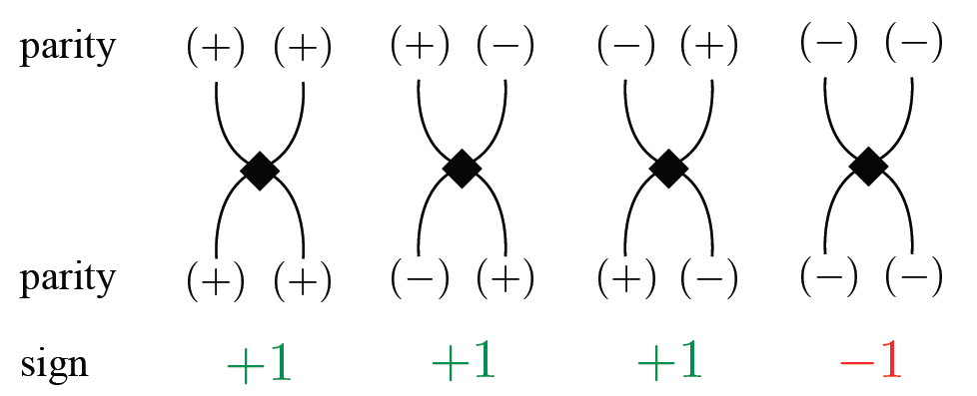
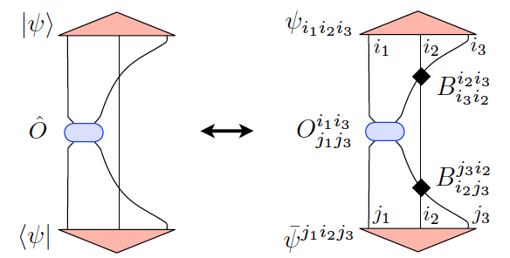
Corboz & Vidal
Phys. Rev. B 80, 165129 (2009)

Slide 14
OK, what now?
We have algorithms that in principle work in 2D. Some results have been published.
Difficulty: scaling of computation cost was horrendous
  First 2D MERA of Evenbly/Vidal:
  Evenbly/Vidal’s refined 2D MERA:
  Evenbly’s most recent 2D MERA:
Also PEPS has large cost:

Slide 15
Variational Monte Carlo
Possible way to make tensor networks faster so we can tackle problems in 2D and even 3D.

Slide 16
Motivation: Make tensor networks faster
χ
Parameters: d^{L} vs. Poly(χ,d,L)
Calculations should be efficient in memory and computation (polynomial in χ, etc)
However total cost might still be HUGE (e.g. 2D)

Slide 17
Monte Carlo makes stuff faster
Monte Carlo: Random sampling of a sum
  Tensor contraction is just a sum
Variational MC: optimizing parameters
Statistical noise!
  Reduced by importance sampling over some positive probability distribution P(s)

Slide 18
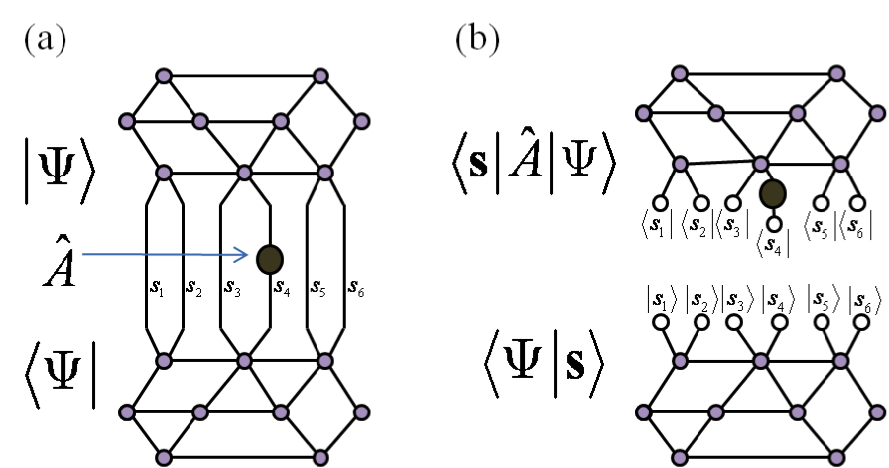
Monte Carlo with Tensor networks

Slide 19
Monte Carlo with Tensor networks

Slide 20
Monte Carlo with Tensor networks
MPS: Sandvik and Vidal, Phys. Rev. Lett. 99, 220602 (2007).
CPS: Schuch, Wolf, Verstraete, and Cirac, Phys. Rev. Lett. 100, 040501 (2008).
Neuscamman, Umrigar, Garnet Chan, arXiv:1108.0900 (2011), etc…
PEPS: Wang, Pižorn, Verstraete, Phys. Rev. B 83, 134421 (2011). (no variational)
…

Slide 21
Monte Carlo with Tensor networks
MPS: Sandvik and Vidal, Phys. Rev. Lett. 99, 220602 (2007).
CPS: Schuch, Wolf, Verstraete, and Cirac, Phys. Rev. Lett. 100, 040501 (2008).
Neuscamman, Umrigar, Garnet Chan, arXiv:1108.0900 (2011), etc…
PEPS: Wang, Pižorn, Verstraete, Phys. Rev. B 83, 134421 (2011). (no variational)
…
Unitary TN: Ferris and Vidal, Phys. Rev. B 85, 165146 (2012).
1D MERA: Ferris and Vidal, Phys. Rev. B, 85, 165147 (2012).

Slide 22
Perfect vs. Markov chain sampling
Perfect sampling: Generating s from P(s)
Often harder than calculating P(s) from s!
Use Markov chain update
e.g. Metropolis algorithm:
  Get random s’
  Accept s’ with probability min[P(s’) / P(s), 1]
Autocorrelation: subsequent samples are “close”

Slide 23
Markov chain sampling of an MPS
Choose P(s) = |<s|Ψ>|² where |s> = |s₁>|s₂> …
Cost is O(χ²L)
2
<s₁|
<s₂|
<s₃|
’
<s₄|
<s₅|
<s₆|
  Accept with probability min[P(s’) / P(s), 1]
A. Sandvik & G. Vidal, PRL 99, 220602 (2007)

Slide 24
Perfect sampling of a unitary MPS
Note that P(s₁,s₂,s₃,…) = P(s₁) P(s₂|s₁) P(s₃|s₁,s₂) …
Cost is now O(χ³L) !

Slide 25
Perfect sampling of a unitary MPS
Note that P(s₁,s₂,s₃,…) = P(s₁) P(s₂|s₁) P(s₃|s₁,s₂) …
if =
Unitary/isometric tensors:

Slide 26
Perfect sampling of a unitary MPS
Note that P(s₁,s₂,s₃,…) = P(s₁) P(s₂|s₁) P(s₃|s₁,s₂) …

Slide 27
Perfect sampling of a unitary MPS
Note that P(s₁,s₂,s₃,…) = P(s₁) P(s₂|s₁) P(s₃|s₁,s₂) …

Slide 28
Perfect sampling of a unitary MPS
Note that P(s₁,s₂,s₃,…) = P(s₁) P(s₂|s₁) P(s₃|s₁,s₂) …

Slide 29
Perfect sampling of a unitary MPS
Note that P(s₁,s₂,s₃,…) = P(s₁) P(s₂|s₁) P(s₃|s₁,s₂) …

Slide 30
Perfect sampling of a unitary MPS
Note that P(s₁,s₂,s₃,…) = P(s₁) P(s₂|s₁) P(s₃|s₁,s₂) …

Slide 31
Perfect sampling of a unitary MPS
Note that P(s₁,s₂,s₃,…) = P(s₁) P(s₂|s₁) P(s₃|s₁,s₂) …
Can sample in any basis…

Slide 32
Perfect sampling of a unitary MPS
Note that P(s₁,s₂,s₃,…) = P(s₁) P(s₂|s₁) P(s₃|s₁,s₂) …

Slide 33
Perfect sampling of a unitary MPS
Note that P(s₁,s₂,s₃,…) = P(s₁) P(s₂|s₁) P(s₃|s₁,s₂) …
Total cost now O(χ²L)

Slide 34
Perfect sampling of a unitary MPS
Note that P(s₁,s₂,s₃,…) = P(s₁) P(s₂|s₁) P(s₃|s₁,s₂) …
Total cost now O(χ²L)

Slide 35
Perfect sampling of a unitary MPS
Note that P(s₁,s₂,s₃,…) = P(s₁) P(s₂|s₁) P(s₃|s₁,s₂) …
Total cost now O(χ²L)

Slide 36
Comparison: critical transverse Ising model
Perfect sampling
Markov chain sampling
Ferris & Vidal, PRB 85, 165146 (2012)

Slide 37
Critical transverse Ising model
Markov chain MC
Perfect sampling
250 sites
50 sites
Ferris & Vidal, PRB 85, 165146 (2012)

Slide 38
Multi-scale entanglement renormalization ansatz (MERA)
Numerical implementation of real-space renormalization group
  remove short-range entanglement
  course-grain the lattice

Slide 39
Sampling the MERA
Cost is O(χ⁹)

Slide 40
Sampling the MERA
Cost is O(χ⁵)

Slide 41
Perfect sampling with MERA

Slide 42
Perfect Sampling with MERA
Cost reduced from O(χ⁹) to O(χ⁵)
Ferris & Vidal, PRB 85, 165147 (2012)

Slide 43
Extracting expectation values
Transverse Ising model
Monte Carlo MERA
Worst case = <H²> - <H>²

Slide 44
Optimizing tensors
Environment of a tensor can be estimated
Statistical noise → SVD updates unstable

Slide 45
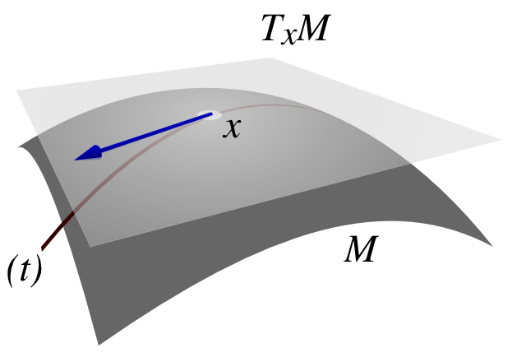
Optimizing isometric tensors
Each tensor must be isometric:
Therefore can’t move in arbitrary direction
  Derivative must be projected to the tangent space of isometric manifold:
  Then we must insure the tensor remains isometric

Slide 46
Results: Finding ground states
Transverse Ising model
Samples
per update
1
2
4
8
Exact
contraction
result
Ferris & Vidal, PRB 85, 165147 (2012)

Slide 47
Accuracy vs. number of samples
Transverse Ising Model
Samples
per update
1
4
16
64
Ferris & Vidal, PRB 85, 165147 (2012)

Slide 48
Discussion of performance
Sampling the MERA is working well.
Optimization with noise is challenging.
New optimization techniques would be great
  “Stochastic reconfiguration” is essentially the (imaginary) time-dependent variational principle (Haegeman et al.) used by VMC community.
Relative performance of Monte Carlo in 2D systems should be more favorable.

Slide 49
Two-dimensional MERA
2D MERA contractions significantly more expensive than 1D
E.g. O(χ¹⁶) for exact contraction vs O(χ⁸) per sample
  Glen has new techniques…
Power roughly halves
  Removed half the TN diagram

Slide 50
Another future direction…
Recent results suggest general time evolution algorithms for tensor networks
  Real time evolution
  Imaginary time evolution
One could improve the updates significantly
  DMRG: 32 sweeps, MERA: thousands…
  MERA could use a DMRG-like update
  Global AND superlinear updates
    CG, Newton’s method and related

