Slide 1


Multiscale
Entanglement
Renormalization
Ansatz
Andy Ferris
International summer school on new trends in computational approaches for many-body systems
Orford, Québec (June 2012)

Slide 2
What will I talk about?
Part one (this morning)
  Entanglement and correlations in many-body systems
  MERA algorithms
Part two (this afternoon)
  2D quantum systems
  Monte Carlo sampling
  Future directions…

Slide 3
Outline: Part 1
Entanglement, critical points, scale invariance
Renormalization group and disentangling
The MERA wavefunction
Algorithms for the MERA
  Extracting expectation values
  Optimizing ground state wavefunctions
  Extracting scaling exponents (conformal data)

Slide 4
Entanglement in many-body systems
A general, entangled state requires exponentially many parameters to describe (in number of particles N or system size L)
However, most states of interest (e.g. ground states, etc) have MUCH less entanglement.
Explains success of many variational methods
  DMRG/MPS for 1D systems
  and PEPS for 2D systems
  and now, MERA

Slide 5
Boundary or Area law for entanglement
=

Slide 6
Boundary or Area law for entanglement
=

Slide 7
Boundary or Area law for entanglement
=

Slide 8
Boundary or Area law for entanglement
=
1D:
2D:
3D:

Slide 9
Obeying the area law:
1D gapped systems
All gapped 1D systems have bounded entanglement in ground state (Hastings, 2007)
  Exists an MPS that is a good approximation

Slide 10
Violating the area law: free fermions
However, simple systems can violate area law
, for an MPS we need
Energy
Fermi level
Momentum

Slide 11
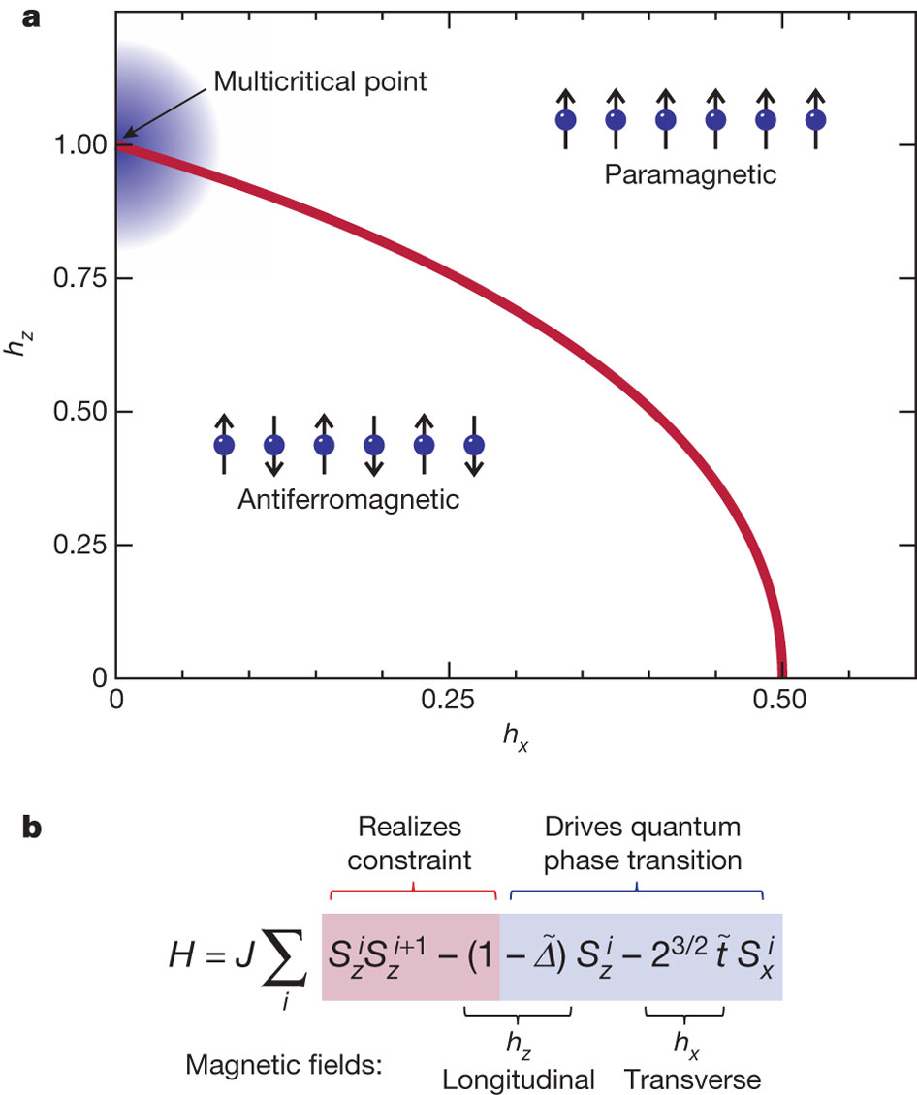
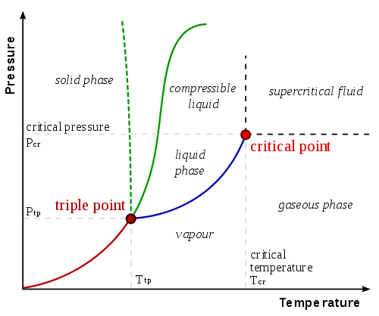
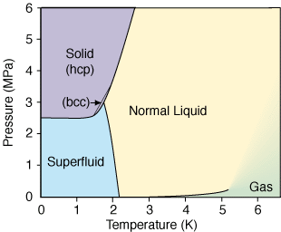
Critical points
Wikipedia
ltl.tkk.fi
Low Temperature Lab, Aalto University
Simon et al., Nature 472, 307–312 (21 April 2011)

Slide 12
Violating the area law: critical systems
Correlation length diverges when approaching critical point
Naïve argument for area law (short range entanglement) fails.
Usually, we observe a logarithmic violation:
Again, MPS/DMRG might become challenging.

Slide 13
Scale-invariance at criticality
Near a (quantum) critical point, (quantum) fluctuations appear on all length scales.
  Remember: quantum fluctuation = entanglement
  On all length scales implies scale invariance.
Scale invariance implies polynomially decaying correlations
Critical exponents depend on universality class

Slide 14
MPS have exponentially decaying correlations
Take a correlator:

Slide 15
MPS have exponentially decaying correlations
Take a correlator:

Slide 16
MPS have exponentially decaying correlations
Exponential decay:

Slide 17
Renormalization group
In general, the idea is to combine two parts (“blocks”) of a systems into a single block, and simplify.
Perform this successively until there is a simple, effective “block” for the entire system.
=

Slide 18
Momentum-space renormalization
Numerical renormalization group (Wilson)
Kondo: couple impurity spin to free electrons
Idea: Deal with low momentum electrons first

Slide 19
Real-space renormalization
=
=
=
=

Slide 20
Tree tensor network (TTN)
=

Slide 21
Tree tensor network as a unitary quantum circuit
Every tree can be written with isometric/unitary tensors with QR decomposition

Slide 22
Tree tensor network as a unitary quantum circuit
Every tree can be written with isometric/unitary tensors with QR decomposition

Slide 23
Tree tensor network as a unitary quantum circuit
Every tree can be written with isometric/unitary tensors with QR decomposition

Slide 24
Tree tensor network as a unitary quantum circuit
Every tree can be written with isometric/unitary tensors with QR decomposition

Slide 25
The problem with trees: short range entanglement
MPS-like entanglement!
=

Slide 26
Idea: remove the short range entanglement first!
For scale-invariant systems, short-range entanglement exists on all length scales
Vidal’s solution: disentangle the short-range entanglement before each coarse-graining
Local unitary to remove short-range entanglement

Slide 27
New ansatz: MERA
Each Layer :
Coarse-graining
Disentangle

Slide 28
New ansatz: MERA
2 sites
4 sites
8 sites
16 sites

Slide 29
Properties of the MERA
Efficient, exact contractions
  Cost polynomial in , e.g.
Allows entanglement up to
Allows polynomially decaying correlations
Can deal with finite (open/periodic) systems or infinite systems
  Scale invariant systems

Slide 30
Efficient computation: causal cones
2 sites
3 sites
3 sites
2 sites
=
=

Slide 31
Causal cone width
The width of the causal cone never grows greater than 3…
This makes all computations efficient!

Slide 32
Efficient computation: causal cones

Slide 33
Efficient computation: causal cones

Slide 34
Efficient computation: causal cones

Slide 35
Efficient computation: causal cones

Slide 36
Entanglement entropy
=
=

Slide 37
Entanglement entropy
=
=

Slide 38
Other MERA structures
MERA can be modified to fit boundary conditions
  Periodic
  Open
  Finite-correlated
  Scale-invariant
Also, renormalization scheme can be modified
  E.g. 3-to-1 transformations = ternary MERA
  Halve the number of disentanglers for efficiency

Slide 39
Periodic Boundaries

Slide 40
Open Boundaries

Slide 41
Finite-correlated MERA
Good for non-critical systems
Maximum length of correlations/entanglement

Slide 42
Scale-invariant MERA

Slide 43
Correlations in a scale-invariant MERA
“Distance” between points via the MERA graph is logarithmic
Some “transfer op-
erator” is applied
times.
=
=

Slide 44
MERA algorithms
Certain tasks are required to make use of the MERA:
Expectation values
  Equivalently, reduced density matrices
Optimizing the tensor network
(to find ground state)
Applying the renormalization procedure
  Transform to longer or shorter length scales

Slide 45
Local expectation values

Slide 46
Global expectation values
This if fine, but sometimes we want to take the expecation value of something translationally invariant, say a nearest-neighbour Hamiltonian.
We can do this with cost
(or with constant cost for the infinite scale-invariant MERA).

Slide 48
A reduced density matrix

Slide 49
Solution: find reduced density matrix
We can find the reduced density matrix averaged over all sites
Realize the binary MERA repeats one of two structures at each layer, for 3-body operators

Slide 50
Reduced density matrix at each length scale

Slide 51
Reduced density matrix at each length scale

Slide 52
Reduced density matrix at each length scale

Slide 53
“Lowering” the reduced density matrix
Cost is

Slide 54
Optimizing the MERA
We need to minimize the energy.
Just like DMRG, we optimize one tensor at a time.
To do this, one needs the derivative of the energy with respect to the tensor, which we call the “environment”
BUT... We need one more ingredient first: raising operators

Slide 55
“Raising” operators

Slide 56
“Raising” operators

Slide 57
“Raising” operators

Slide 58
“Raising” operators
Cost is

Slide 59
Environments/Derivatives

Slide 60
Environments/Derivatives
Cost is

Slide 61
Single-operator updates: SVD
Question: which unitary minimizes the energy?
Answer: the singular-value decomposition gives the answer.
Thoughts:
  Polar decomposition is more direct
  Solving the quadratic problem could be more efficient – and more like the DMRG algorithm.

Slide 62
Scaling Super-operator
By now, you might have noticed the repeating diagram:

Slide 63
Defines a map from the purple to the yellow, or from larger to smaller length scales and vice-versa
The map takes Hermitian operators to Hermitian operators – it is a superoperator
The superoperator is NOT Hermitian

Slide 64
The descending super-operator
Operator has
a spectrum,
with a single
eigenvalue 1.
Maximum eigenvector of descending superoperator = reduced density matrix of scale invariant MERA!
Cost is

Slide 65
The Ascending Superoperator
The identity the
eigenvector with
eigenvalue 1 for the
ascending superoperator.
The Hamiltonian will not be an eigenvector of the superoperator, in general (though CFT tells us that it will approach the second largest eigenvalue once the MERA is optimized).

Slide 66
Optimizing scale-invariant MERA
We need to optimize tensors that appear on all length scales.
  Use fixed-point density matrix
  Use Hamiltonian contributions from all length scales:
Cost is

Slide 67
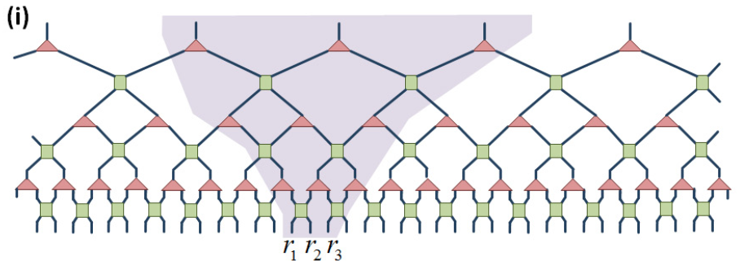
Other forms of 1D MERA
Slight variations allow for computational gains
Cost is
Glen Evenbly,
arXiv:1109.5334 (2011)

Slide 68
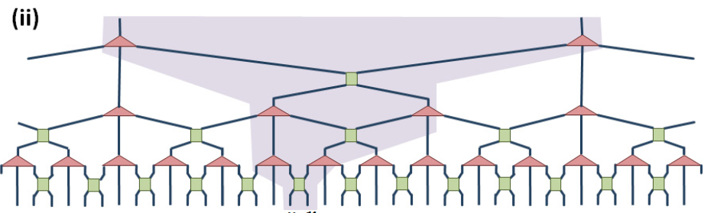
Ternary MERA
3-to-1 tranformation, causal cone width 2
Cost reduced to
Glen Evenbly,
arXiv:1109.5334 (2011)

Slide 69
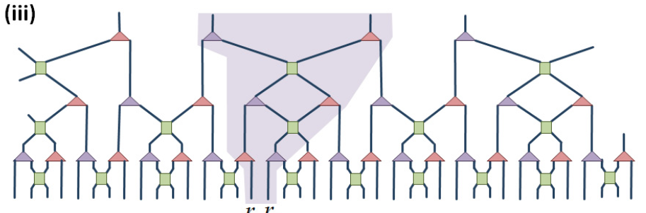
More efficient, binary MERA
Alternatively, remove half the disentanglers
Cost reduces to or to with approx.
Glen Evenbly,
arXiv:1109.5334 (2011)

Slide 70
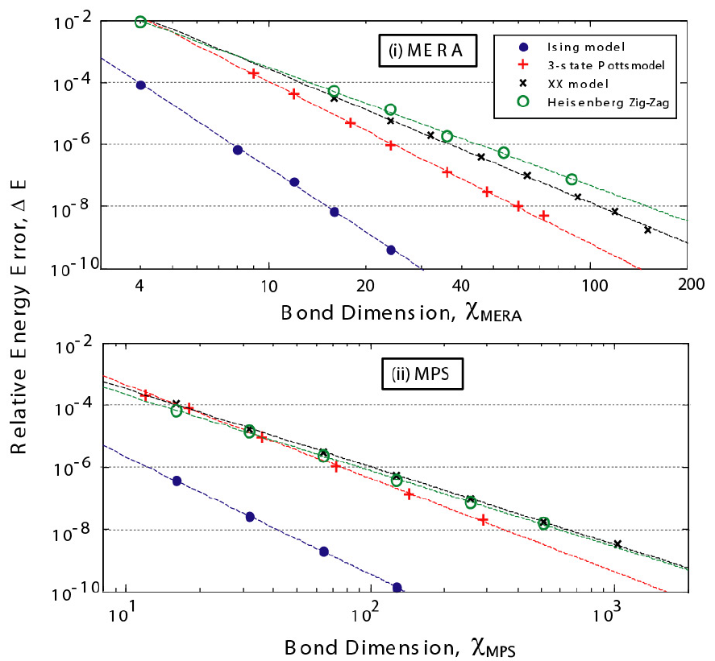
Scaling of cost
Cost is vs
MERA is as efficient as MPS done
with cost
Glen Evenbly, arXiv:1109.5334 (2011)

Slide 71
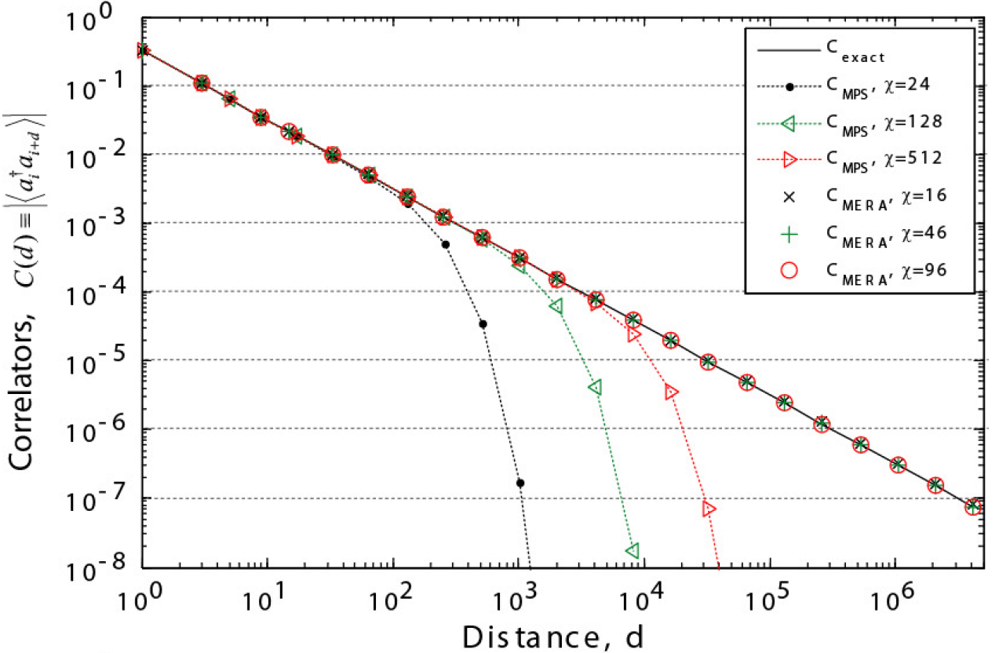
Correlations: MPS vs MERA
Quantum XX model
Glen Evenbly,
arXiv:1109.5334 (2011)

Slide 72
Brief intro to conformal field theory
Conformal field theory describes the universality class of the phase transition
Amongst other things, it gives a set of operators and their scaling dimensions
From scale-invariant MERA, we can extract both these scaling dimensions and the corresponding operators

Slide 73
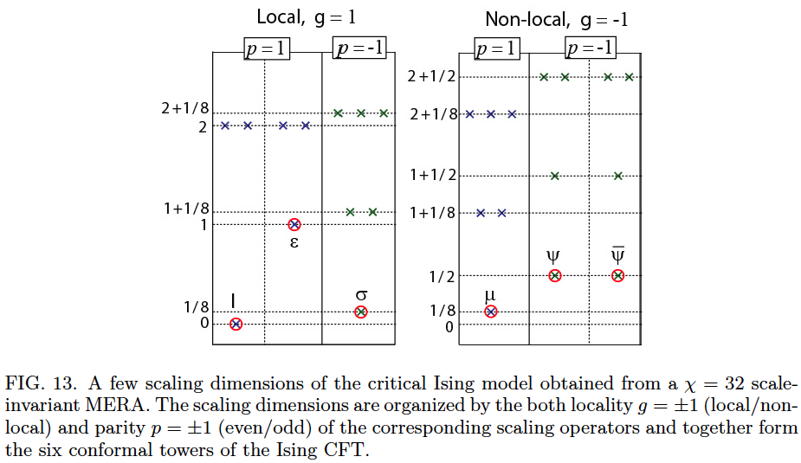
Scaling exponents from the MERA
Glen Evenbly,
arXiv:1109.5334 (2011)

Slide 74
Outline: Part 2
What about 2D?
  Area laws for MPS, PEPS, trees, MERA, etc…
  MERA in 2D, fermions
Some current directions
  Free fermions and violations of the area law
  Monte Carlo with tensor networks
  Time evolution, etc…

